Slide 1
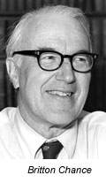
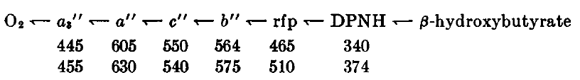
The Respiratory Chain,
BC and now
Britton Chance: His Life, Times & Legacy
Philadelphia, 3rd June, 2011
Mårten Wikström
University of Helsinki
1955
2011

Slide 2
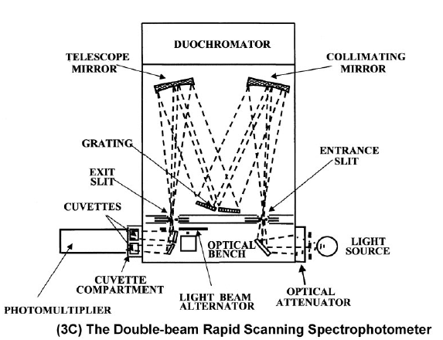
INSTRUMENT DESIGN AND DEVELOPMENT!
from R.W. Estabrook (2003) DMD 31, 1461

Slide 3
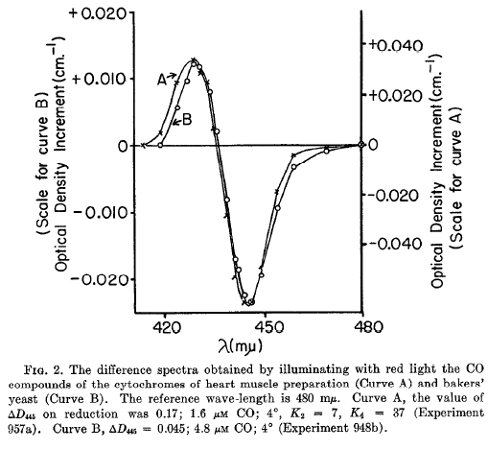
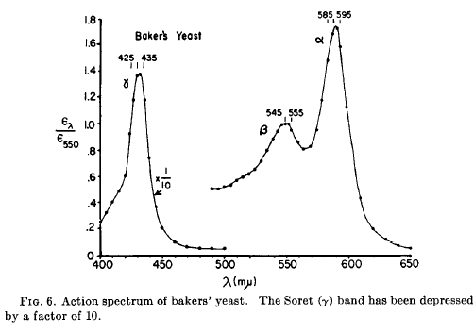
Definite identification of Keilin's cytochrome a₃ of cytochrome
oxidase with Warburg's Atmungsferment by accurate photodissociation
spectra of heme a₃[II]-CO and the action spectrum of CO-treated yeast
Chance (1953) J. Biol. Chem. 202, 397
Castor & Chance (1955)
J. Biol. Chem. 217, 453

Slide 4
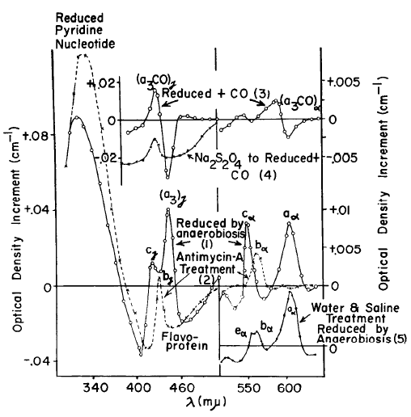
The light absorption properties of most components
of the respiratory chain - the basis for all our subsequent
knowledge of its structure and function
Chance & Williams (1955) J. Biol. Chem. 217, 395

Slide 5
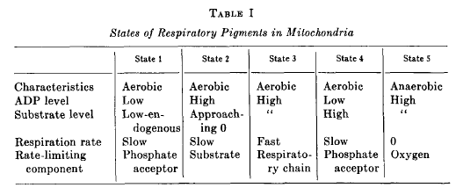
THE DYNAMICS AND CONTROL OF MITOCHONDRIAL RESPIRATION
THE CLASSICAL "STEADY STATES"
Chance & Williams (1955) J. Biol. Chem. 217, 409

Slide 7
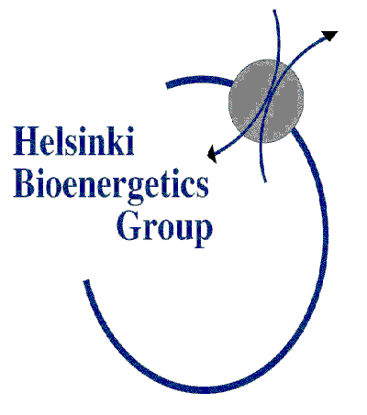
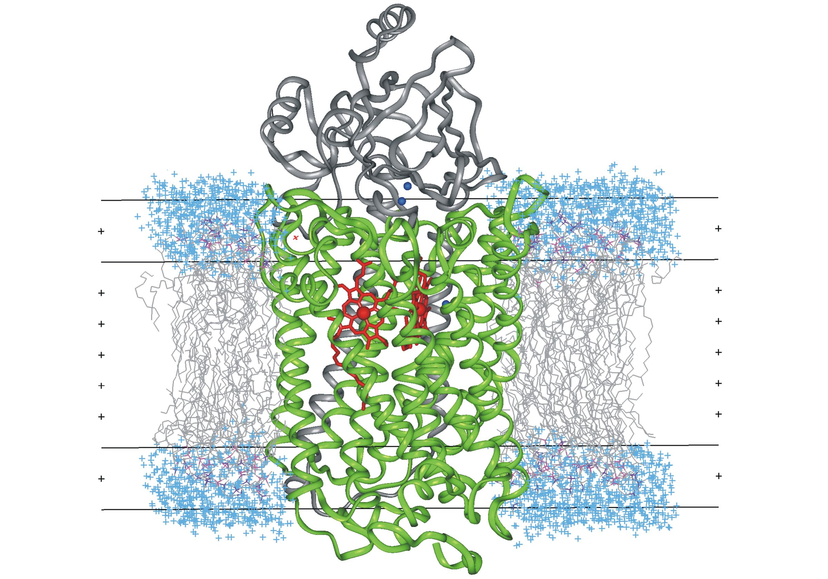
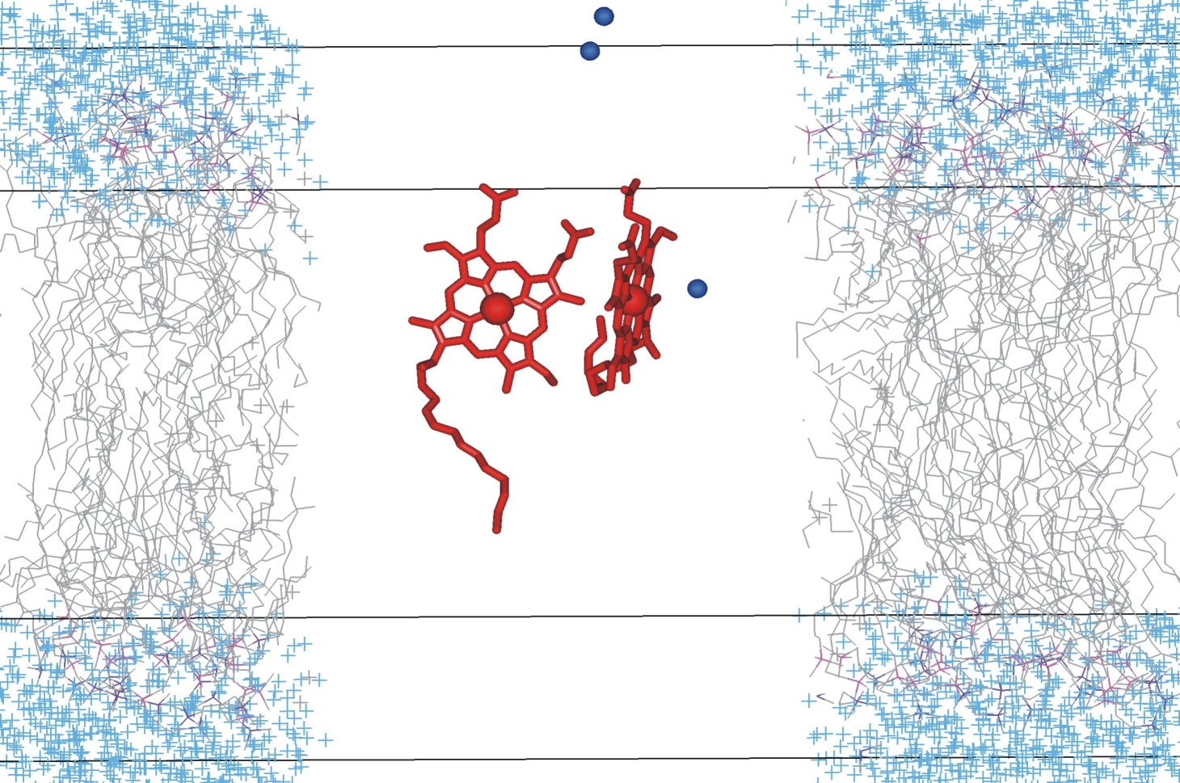
Redox centres and electron transfer sequence
e⁻
CYT. C
Cu_{A}
Cu_{B}
heme a
O₂
heme a₃

Slide 8
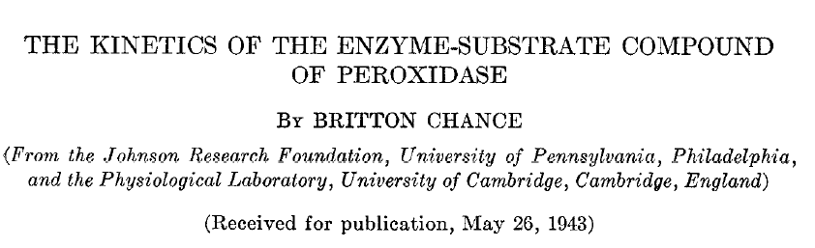
The Journal of Biological Chemistry
151 (1943) 553

Slide 9
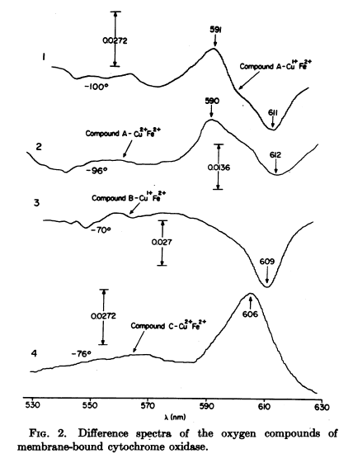
Discovery of the O₂ adduct of
cytochrome oxidase, the
enzyme-substrate complex of
cell respiration
Low temperature "triple-trapping"
technique
Cmpnd A₁
Cmpnd A₂
Chance, Saronio, Leigh (1975)
Proc. Natl. Acad. Sci. USA
72, 1635

Slide 10
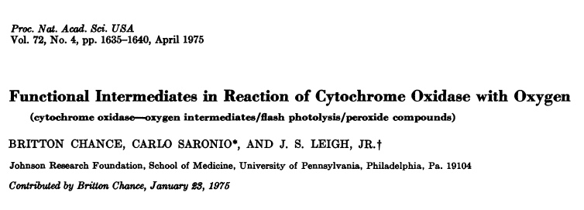
The difference spectrum
"Compound B" minus photodissociated fully reduced enzyme
shows a trough at ~609 nm!
The difference spectrum
"Compound C" minus photodissociated mixed valence enzyme shows a peak at 606 nm!

Slide 11
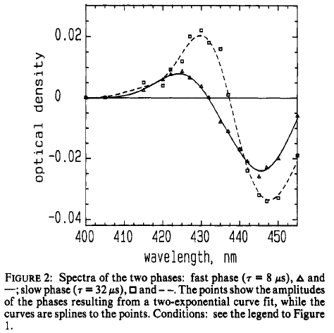
Initial reaction steps when fully reduced enzyme reacts with O₂
R
8 μs
A
32 μs
P_{R}
100 μs
F
O₂
e⁻
H⁺
Fe^{II}
Cu^{I}
Fe^{II}
O₂
Cu^{I}
Fe^{IV}
=O²⁻
Cu^{II}
Fe^{IV}
=O²⁻
Cu^{II}
HO-tyr
HO-tyr
⁻O-tyr
OH⁻
⁻O-tyr
HOH
Verkhovsky, Morgan & Wikström (1994)
Biochemistry 33, 3079-3086
P_{R}
A
Cmpnd B:
trough in the
difference
spectrum relative
to fully reduced

Slide 12
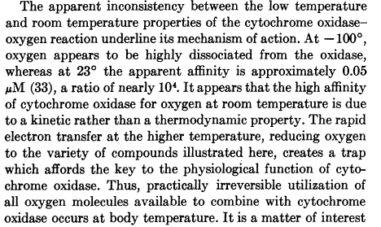
The high apparent affinity of cell respiration to O₂
is not the result of tight binding to the active site of
cytochrome oxidase, but to "kinetic trapping" by fast
electron transfer to the bound substrate
Chance, Saronio & Leigh (1975) Proc. Natl. Acad. Sci. USA 72, 635

Slide 13
Initial reaction steps when fully reduced enzyme reacts with O₂
R
8 μs
A
32 μs
P_{R}
O₂
e⁻
Fe^{II}
Cu^{I}
Fe^{II}
O₂
Cu^{I}
Fe^{IV}
=O²⁻
Cu^{II}
HO-tyr
HO-tyr
⁻O-tyr
OH⁻
Verkhovsky, Morgan & Wikström (1994)
Biochemistry 33, 3079-3086
P_{R}
Oxygen binding is reversible
(weak)! K_{d} ~ 0.28 mM at room
temperature
(compare with K_{M}~0.1 μM!)
A

Slide 14
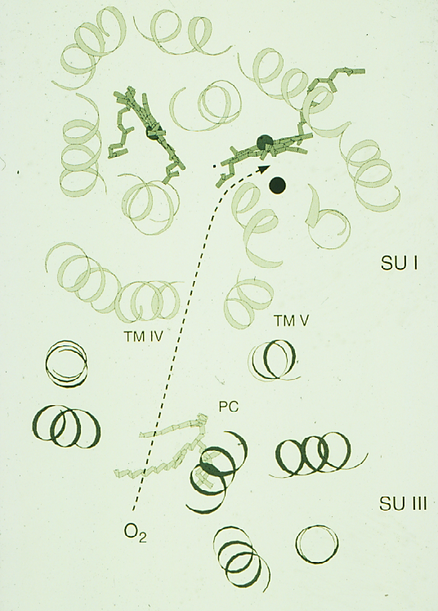
Unhindered O₂ diffusion to the active site
Valine 279
O₂ diffuses to the active heme
iron/copper site from the
membrane, where its concentra-
tion is almost 10-fold compared to
that in the surrounding aqueous
solutions.
The structure shows a diffusion
pathway for oxygen that has been
verified by site-directed
mutagenesis experiments.
This pathway secures very fast
diffusion that requires little or no
conformational adjustments by the
protein structure.
Riistama et al. [1996]
Biochim. Biophys. Acta
1275, 1-4.

Slide 15
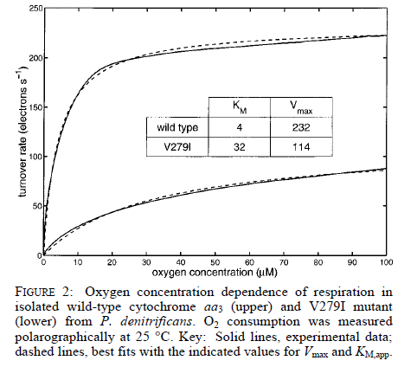
The (apparent) Michaelis constant (K_{M}) is a complex
function of kinetic trapping of bound O₂ and the rate
of dioxygen diffusion into the binding site
Riistama et al. (2000) Biochemistry 39, 6365

Slide 16
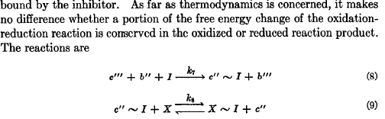
Postulated high-energy intermediates of respiratory carriers
Chance, Williams, Holmes & Higgins (1955) J. Biol. Chem. 217, 439

Slide 17
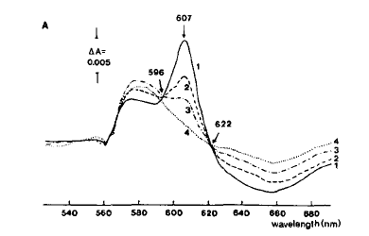
Energy-dependent (ATP-induced) change in the absorption
spectrum of oxidised cytochrome c oxidase in intact mitochondria
Was this evidence for C'''~I ?

Slide 18
The difference spectrum
"Compound C" minus photodissociated mixed
valence enzyme shows a peak at 606 nm!

Slide 19
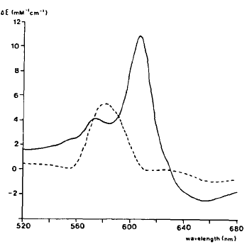
ENERGY-DEPENDENT REVERSAL OF PART OF
THE CATALYTIC CYCLE
Britton Chance's original nomenclature in red (1975)
Compound A
Compound C
HO-tyr
O₂
HO-tyr
*O-tyr
R
Fe^{II}
Cu^{I}
Fe^{II}
O₂
Cu^{I}
Fe^{IV}
=O
Cu^{II}
P_{M}
OH
A
H⁺
H₂O
e⁻
e⁻
H⁺
H⁺
HO-tyr
⁻O-tyr
E_{H}
Fe^{III}
OH
Cu^{I}
Fe^{IV}
=O
Cu^{II}
F
HOH
H⁺
H₂O
H⁺
e⁻
e⁻
⁻O-tyr
Fe^{III}
OH
Cu^{II}
HOH
H⁺
O_{H}
Wikström (1981) PNAS 78, 4051

Slide 20
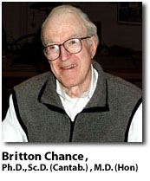
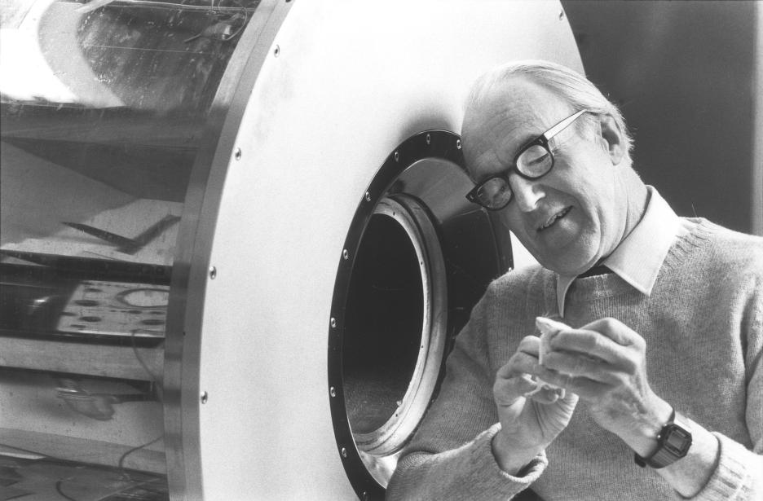
- Brit provided the key tools and information needed for
studying the dynamics and the reaction mechanisms
in the respiratory chain
- His work laid the grounds for our
understanding of how the chain
works, and greatly inspired
subsequent work by others
- His description of how the respiratory
enzyme reacts with oxygen is still valid,
and forms the basis for our current
understanding of cellular respiration

Slide 23
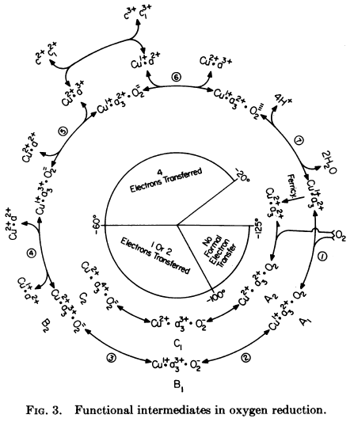
Chance, Saronio, Leigh (1975)
Proc. Natl. Acad. Sci. USA
72, 1635

Slide 24
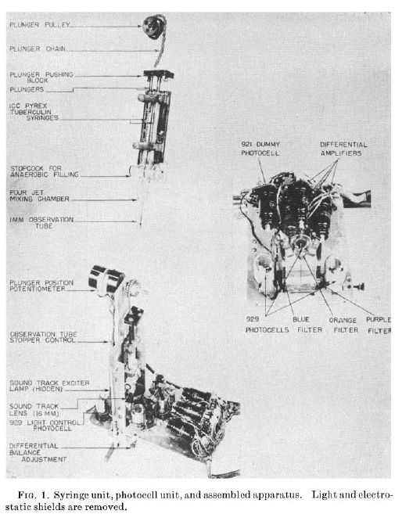
RAPID MIXING DEVICES

Slide 25
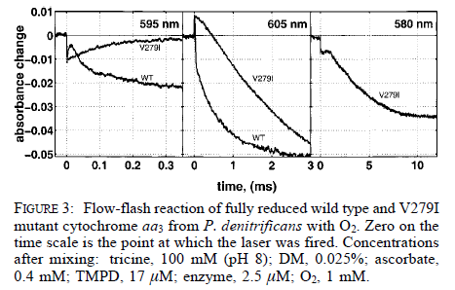
Formation of the dioxygen adduct, Chance’s Compound A,
at room temperature
The effect of blocking the O₂ diffusion channel
Riistama et al. (2000) Biochemistry 39, 6365

Slide 26
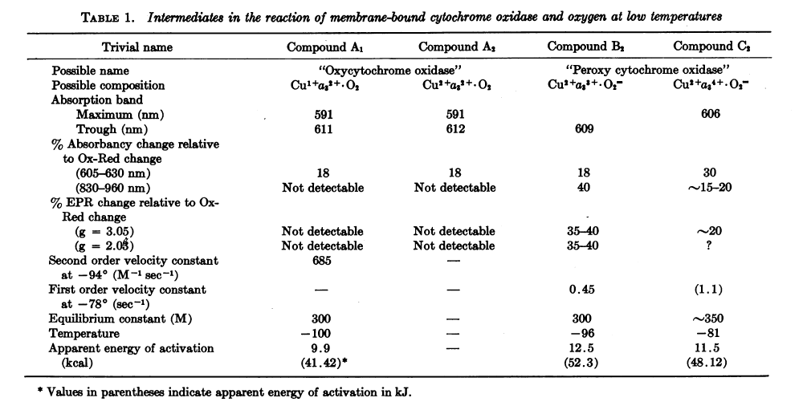
Chance, Saronio & Leigh (1975) Proc. Natl. Acad. Sci. USA 72, 1635

Slide 27
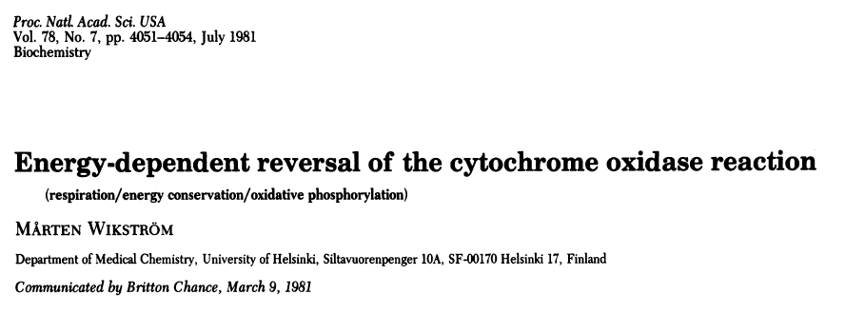
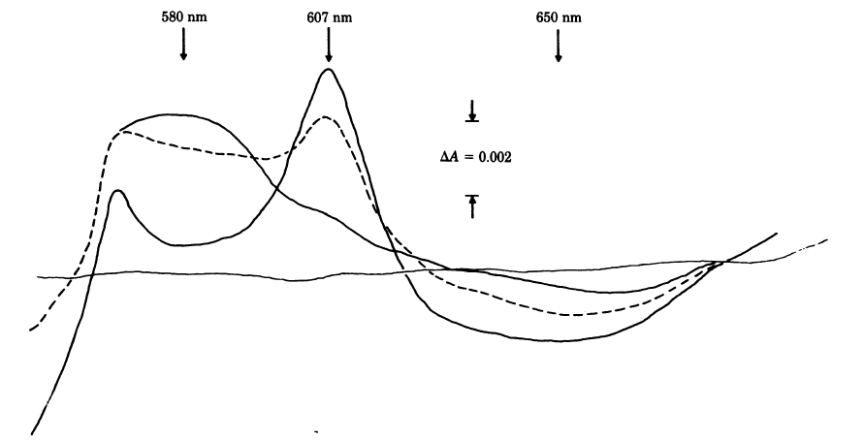

Slide 28
The difference spectrum
"Compound B" minus photodissociated fully reduced enzyme
shows a trough at ~609 nm!

Slide 29
THE TWO STAGES OF THE Q CYCLE

Slide 30
CATALYTIC CYCLE
Starting from ”mixed valence” enzyme reacting with O₂
Britton Chance's original nomenclature in red (1975)
Compound A₂
Compound C
HO-tyr
O₂
HO-tyr
*O-tyr
R
Fe^{II}
Cu^{I}
Fe^{II}
O₂
Cu^{I}
Fe^{IV}
=O
Cu^{II}
P_{M}
OH
A
H⁺
H₂O
e⁻
e⁻
H⁺
HO-tyr
⁻O-tyr
E_{H}
Fe^{III}
OH
Cu^{I}
Fe^{IV}
=O
Cu^{II}
F
HOH
H⁺
H₂O
H⁺
e⁻
e⁻
⁻O-tyr
Fe^{III}
OH
Cu^{II}
HOH
O_{H}

Slide 31
CATALYTIC CYCLE
Starting from fully reduced enzyme reacting with O₂
Compound A₁
H⁺
R
O₂
A
P_{R}
e⁻
Fe^{II}
Cu^{I}
Fe^{II}
O₂
Cu^{I}
Fe^{IV}
=O²⁻
Cu^{II}
HO-tyr
HO-tyr
⁻O-tyr
OH⁻
GluH
GluH
Glu⁻
H₂O
H⁺
H⁺
e⁻
H⁺
H⁺
E_{H}
F
Fe^{III}
OH⁻
Cu^{I}
Fe^{IV}
Cu^{II}
O²⁻
=
Compound B
HO-tyr
⁻O-tyr
HOH
GluH
GluH
H⁺
H₂O
H⁺
e⁻
e⁻
O_{H}
OH⁻
Cu^{II}
Fe^{III}
OH⁻
HOH
⁻O-tyr
GluH

Slide 32
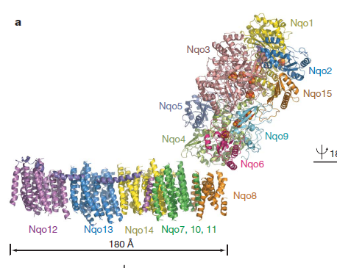
Complex I from Thermus thermophilus
From G. Efremov, R. Baradaran & L. Sazanov (2010)
Nature 465, 441

Slide 33
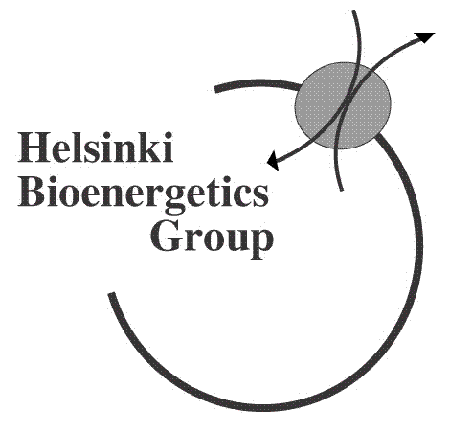
Basic chemistry of dioxygen reduction
(at neutral pH)
O₂^{.-}
superoxide
O₂..
(triplet state
chemically inert
at ambient
temperature)
H₂O₂
peroxide
OH.
energy
hydroxyl radical
H₂O
H₂O
water
0
1
2
3
4
number of electrons

Slide 34
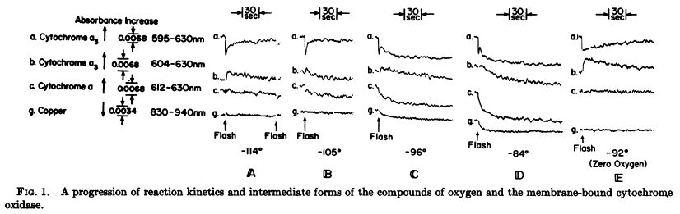

Slide 36
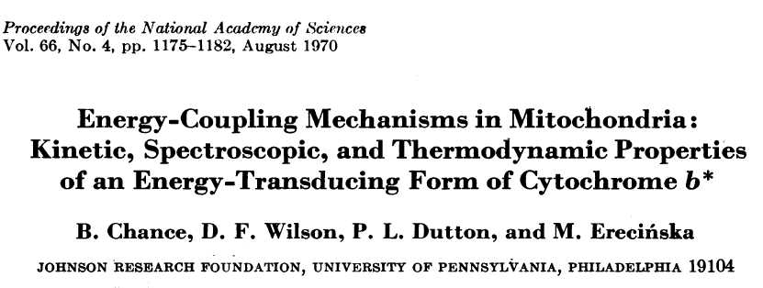
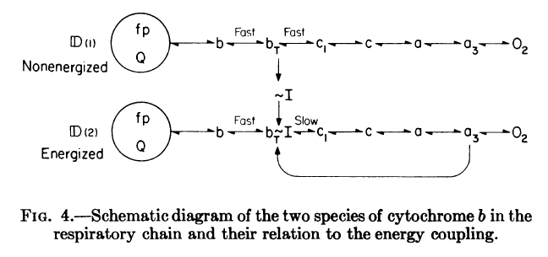

Slide 37
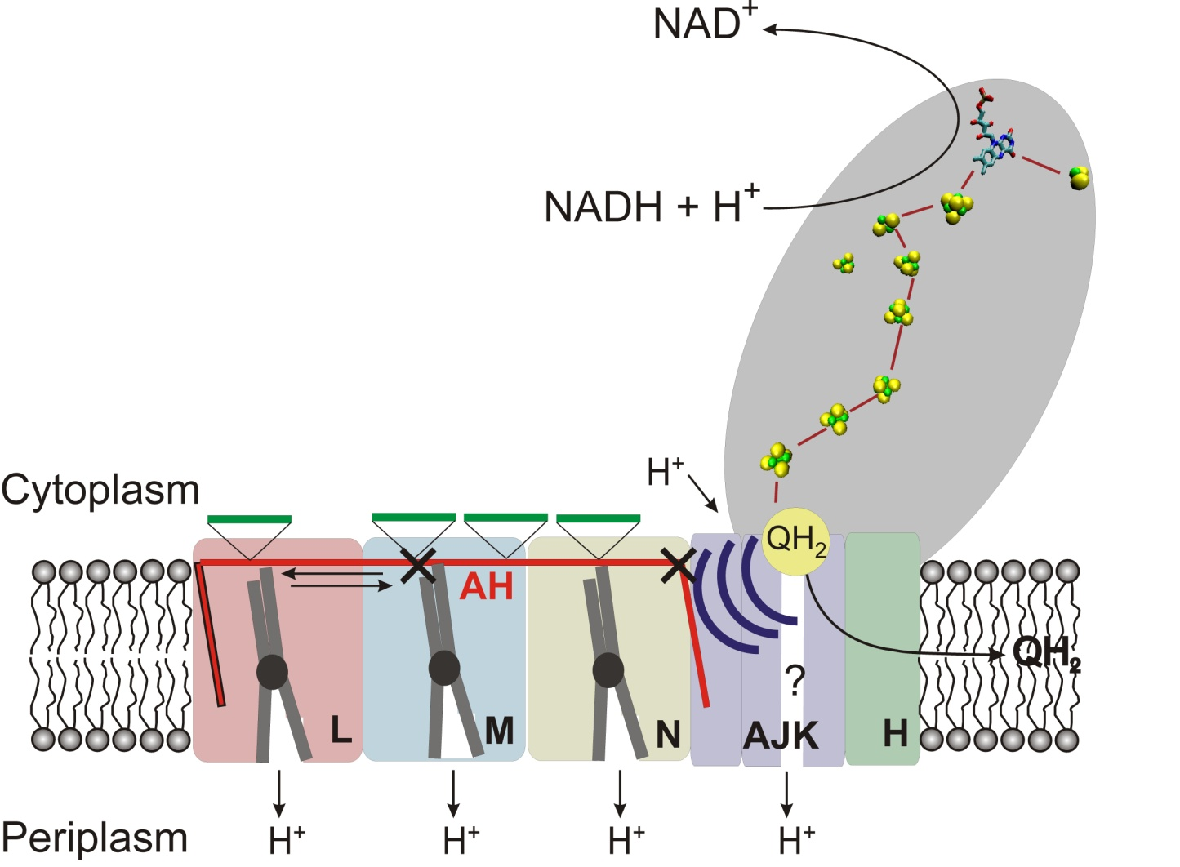
A MECHANICAL PISTON MODEL OF PROTON-PUMPING IN COMPLEX I
After G. Efremov, R. Baradaran & L. Sazanov (2010) Nature 465, 441

Slide 38
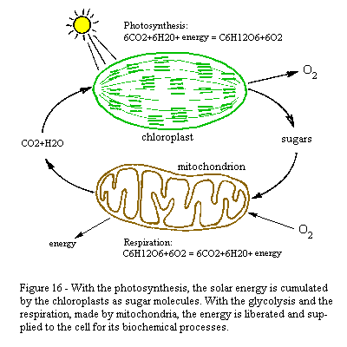

Slide 39
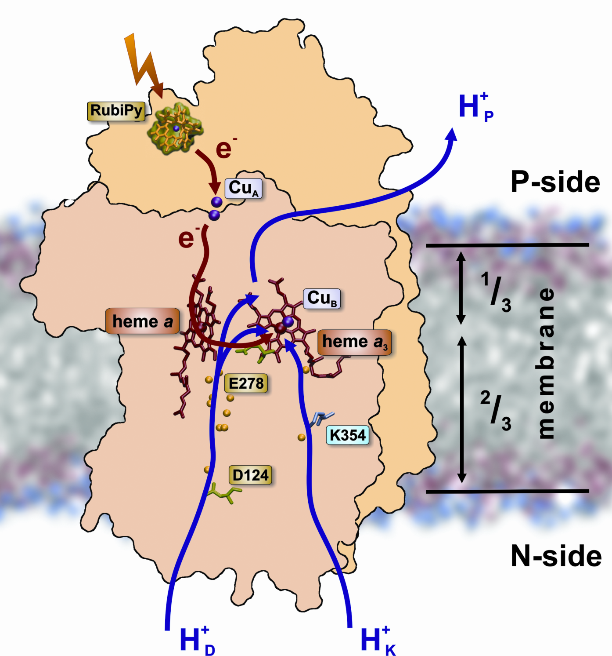
cyt. c
"pump
site"

Slide 40
EXPERIMENT:
Photoinjection of an electron
(~20% quantum efficiency)
into oxidase in the O_{H} state
"pump
site"
→ follow the trajectory of
the electron by optical
spectroscopy
→follow the translocation
of electrical charge by
time-resolved capacitatively
coupled electrometry
I. Belevich et al. PNAS (2007)
104, 2685

Slide 41
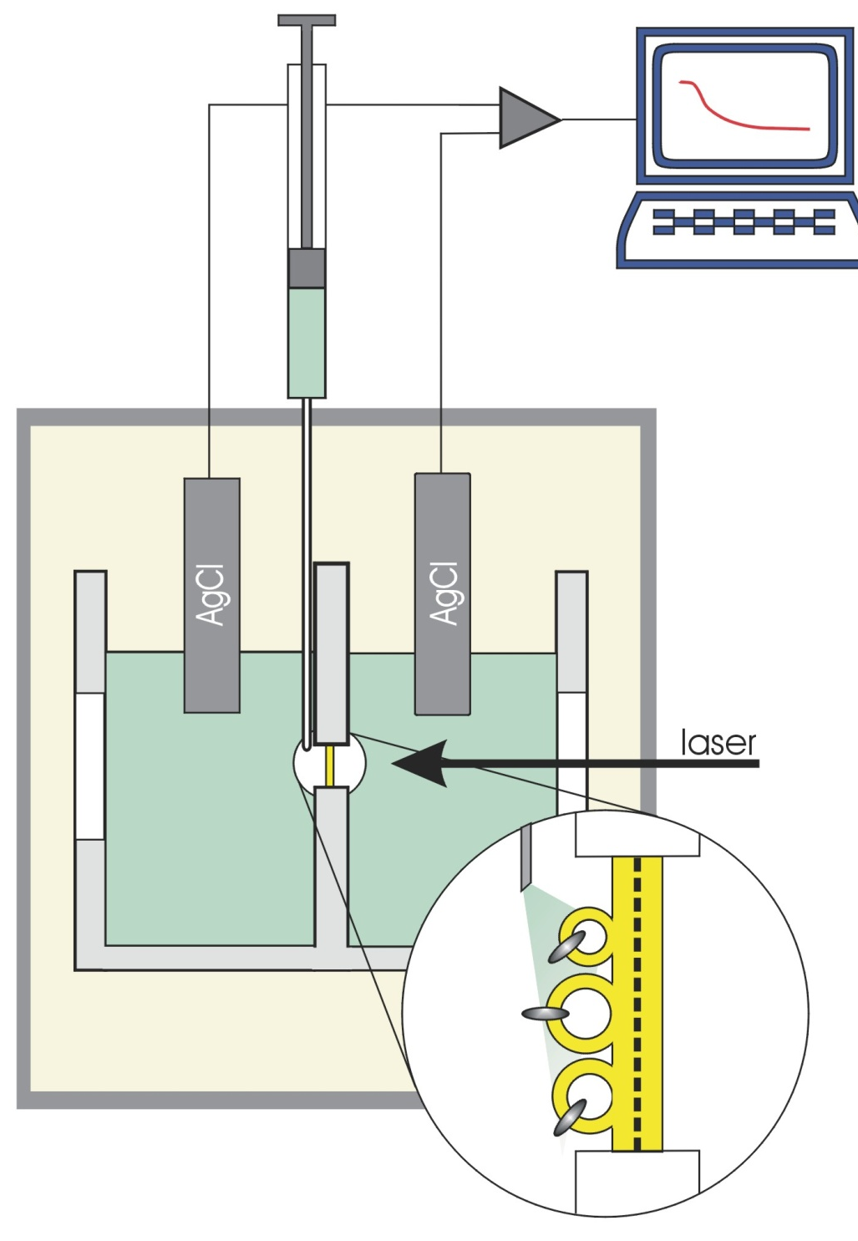
TIME-RESOLVED MEASUREMENT OF
CHARGE TRANSLOCATION
electrometric setup
capacitatively coupled
electrometric circuitry
O₂
O₂
measuring
membrane
P-lipid vesicles
incorporated
with oxidase

Slide 42
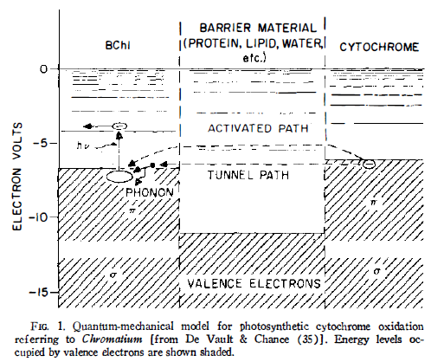
Quantum-chemical electron tunneling in biology
(originally in bacterial photosynthesis)
From: D.S. Bendall & R. Hill [1968] Ann. Rev. Plant. Physiol. 19, 167

Slide 43

Experimental setup for measurement of electric potential generation
time resolution <1 μs
Experimental setup for time-resolved optical spectroscopy
1 spectrum each microsecond
RubiPy
aniline

Slide 44
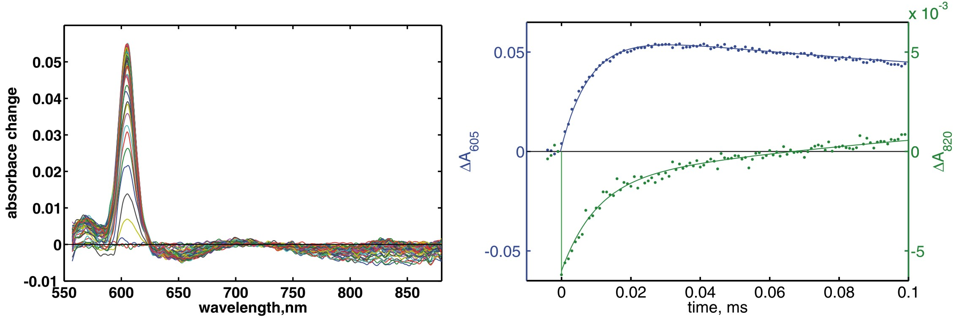
Spectral recording of electron injection kinetics
absorbance
time
wavelength
heme a
Cu_{A}

Slide 45
Electron injection kinetics

Slide 46
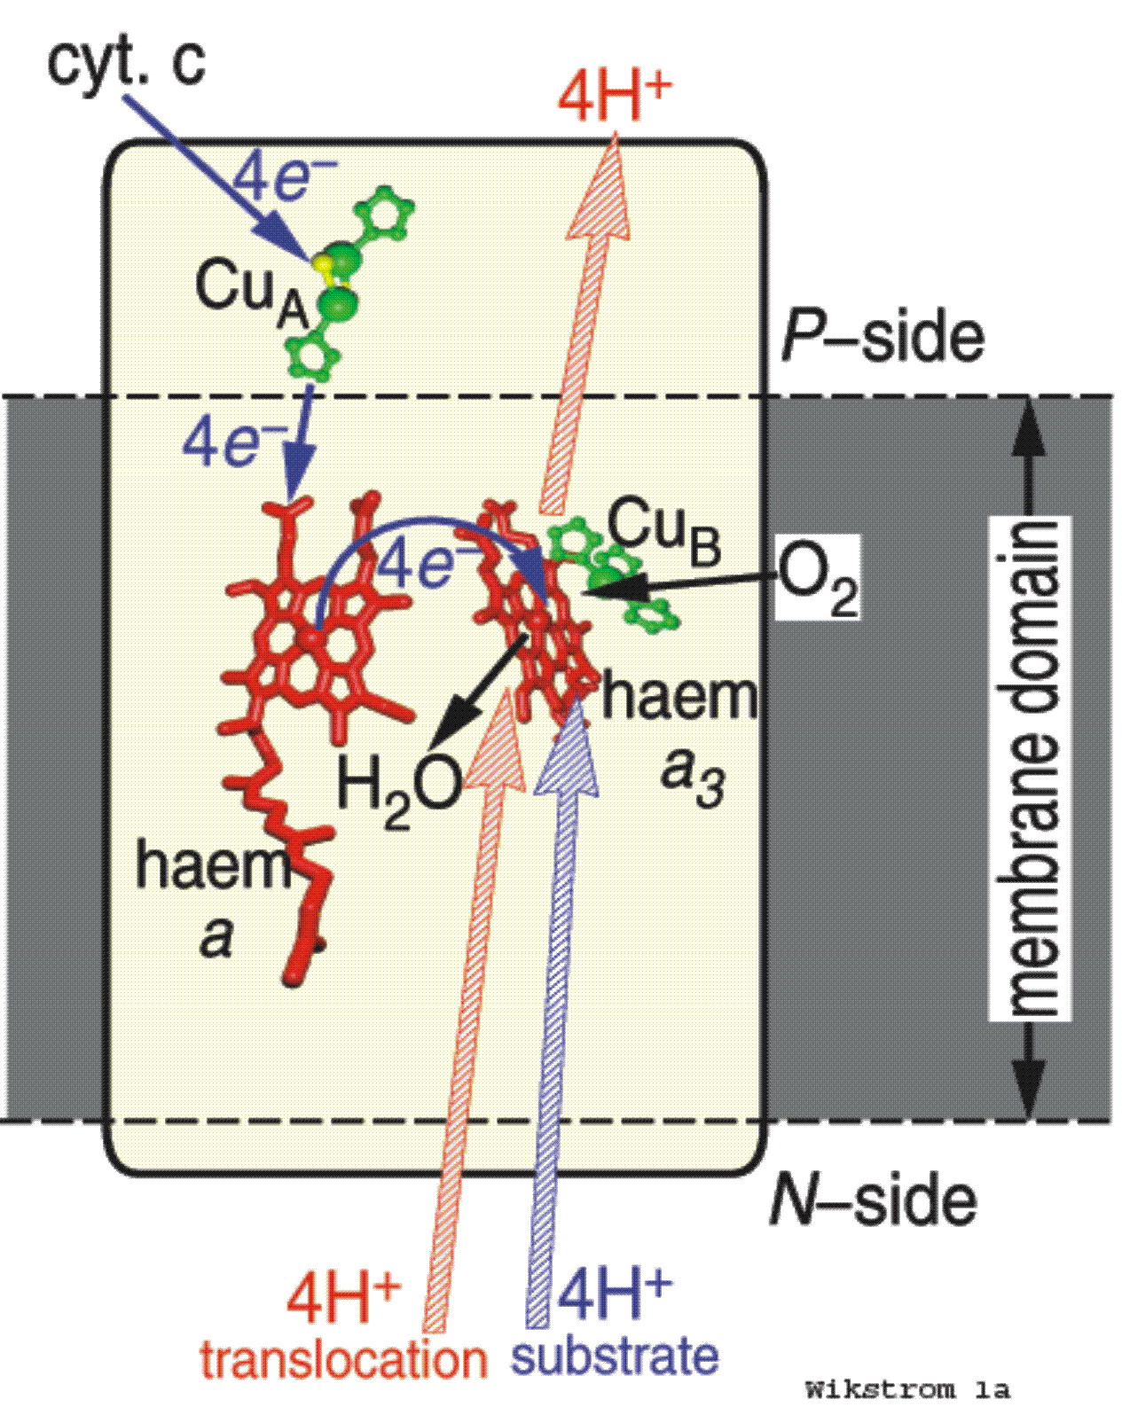
SCHEMATIC FUNCTIONING
OF CYTOCHROME c OXIDASE
AS A PROTON PUMP

Slide 47
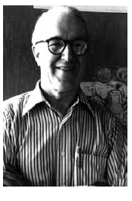

Slide 48
Wikström et al. [48-50] have recently shown that the conformational changes
observed in cytochrome oxidase (as evidenced by the energy-linked spectral shifts
and change in affinity for cyanide) may be the response of the membraneous
enzyme complex toward the establishment of an electrical gradient across the mitochondrial membrane. The mechanism of respiratory control at cytochrome c oxidase proposed by Mitchell [55] simply assumes that the electric field across the membrane would interact directly with transmembrane electron transport from cytochrome c to cytochrome aa. Since no energy-linked conformational changes
of the hemes are expected a priori from such kind of a mechanism we would
propose as an alternative that the electric field and the pH gradient influence the kinetic and thermodynamic properties of the hemes via a conformational change
of the complex.

Slide 50
ANALOGY BETWEEN A SIMPLE ELECTRICAL CIRCUIT
AND PRIMARY BIOLOGICAL ENERGY TRANSDUCTION
ELECTRICITY!
insulated electron
conductors
e⁻
lamp,
motor, etc
battery
SIMPLE
ELECTRICAL
CIRCUIT
e⁻
PROTICITY!
proton conduction by
the aqueous phases on
each side of membrane
H⁺
respiratory chain
BIOLOGICAL
ENERGY
TRANSDUCTION
ATP synthase
H⁺
THE PHOSPHOLIPID MEMBRANE FUNCTIONS AS THE INSULATOR!

Slide 51
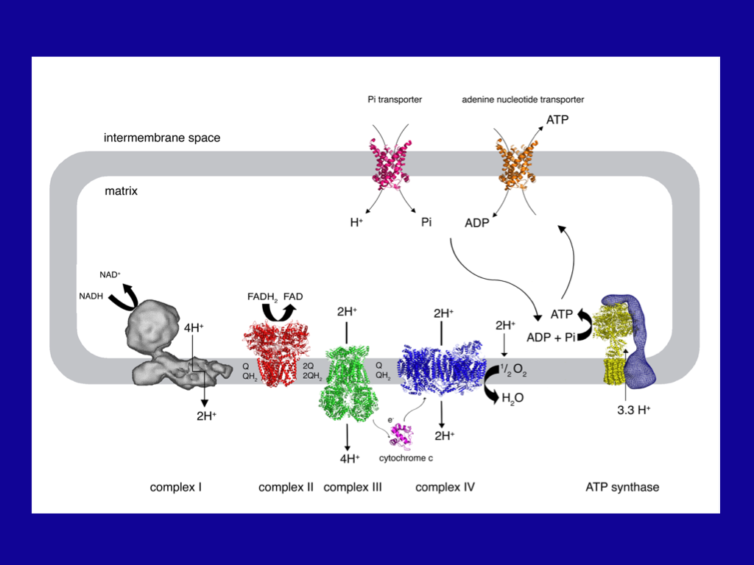
H₂PO₄⁻
H₂PO₄⁻
4-
electroneutral
symporter
-
electrogenic
antiporter
-
3⁻
4H⁺
Courtesy: Prof. J.E. Walker

Slide 52
CATALYTIC CYCLE
Starting from fully reduced enzyme reacting with O₂
H⁺
R
O₂
A
P_{R}
e⁻
Fe^{II}
Cu^{I}
Fe^{II}
O₂
Cu^{I}
Fe^{IV}
=O²⁻
Cu^{II}
HO-tyr
HO-tyr
⁻O-tyr
OH⁻
GluH
GluH
Glu⁻
H₂O
H⁺
H⁺
e⁻
H⁺
H⁺
E_{H}
F
Fe^{III}
OH⁻
Cu^{I}
Fe^{IV}
Cu^{II}
O²⁻
=
HO-tyr
⁻O-tyr
HOH
GluH
GluH
H⁺
H₂O
H⁺
e⁻
e⁻
O_{H}
OH⁻
Cu^{II}
Fe^{III}
OH⁻
HOH
⁻O-tyr
GluH

Slide 53
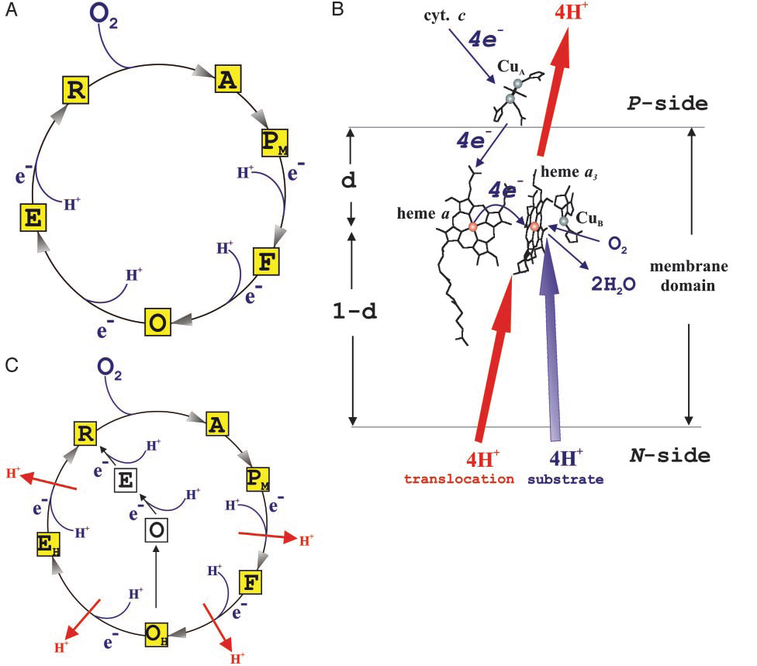

Slide 54
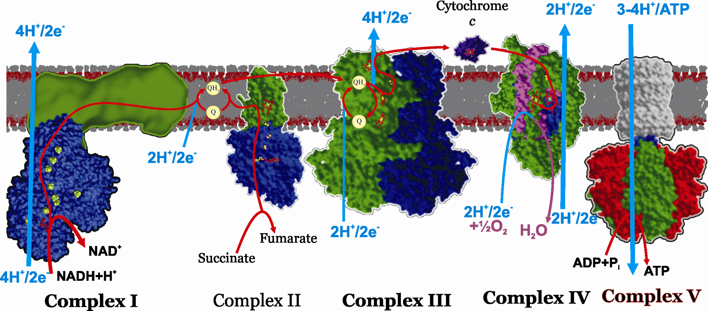
RESPIRATORY CHAIN AND ATP SYNTHASE
2.7 H⁺/ATP

Slide 55
CATALYTIC CYCLE
A
HO-tyr
O₂
HO-tyr
*O-tyr
R
Fe^{II}
Cu^{I}
Fe^{II}
O₂
Cu^{I}
Fe^{IV}
=O
Cu^{II}
P_{M}
OH
H₂O
H⁺
e⁻
e⁻
H⁺
HO-tyr
⁻O-tyr
E_{H}
Fe^{III}
OH
Cu^{I}
Fe^{IV}
=O
Cu^{II}
F
HOH
H⁺
H₂O
H⁺
e⁻
e⁻
⁻O-tyr
Fe^{III}
OH
Cu^{II}
HOH
O_{H}

Slide 56
RESPIRATORY CHAIN AND ATP SYNTHASE
NAD⁺ + H⁺
NADH
S
+H⁺
SH₂
Complex I Complex II Complex III Complex IV Complex V

Slide 57
CATALYTIC CYCLE AT LOW pH
Starting from fully reduced enzyme reacting with O₂
H⁺
R
O₂
A
P_{R}
e⁻
Fe^{II}
Cu^{I}
Fe^{II}
O₂
Cu^{I}
Fe^{IV}
=O²⁻
Cu^{II}
HO-tyr
HO-tyr
⁻O-tyr
OH⁻
GluH
GluH
Glu⁻
H⁺
H⁺
e⁻
H⁺
E
F
Fe^{III}
Cu^{I}
Fe^{IV}
O²⁻
Cu^{II}
=
HO-tyr
⁻O-tyr
HOH
GluH
GluH
H⁺
H⁺
H⁺
e⁻
e⁻
O
HOH
OH⁻
Cu^{II}
Fe^{III}
HOH
⁻O-tyr
HOH
GluH

Slide 58
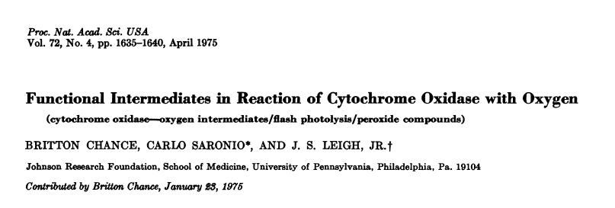
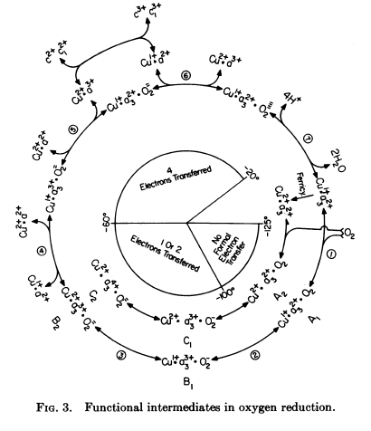

Slide 59
CATALYTIC CYCLE
Electron injection starting from oxidised state
A
HO-tyr
O₂
HO-tyr
*O-tyr
R
Fe^{II}
Cu^{I}
Fe^{II}
O₂
Cu^{I}
Fe^{IV}
=O
Cu^{II}
P_{M}
OH
H⁺
e⁻
e⁻
H⁺
HO-tyr
⁻O-tyr
E
Fe^{III}
Cu^{I}
Fe^{IV}
=O
Cu^{II}
F
OH
HOH
H⁺
e⁻
e⁻
HO-tyr
Fe^{III}
Cu^{II}
OH
O

Slide 60
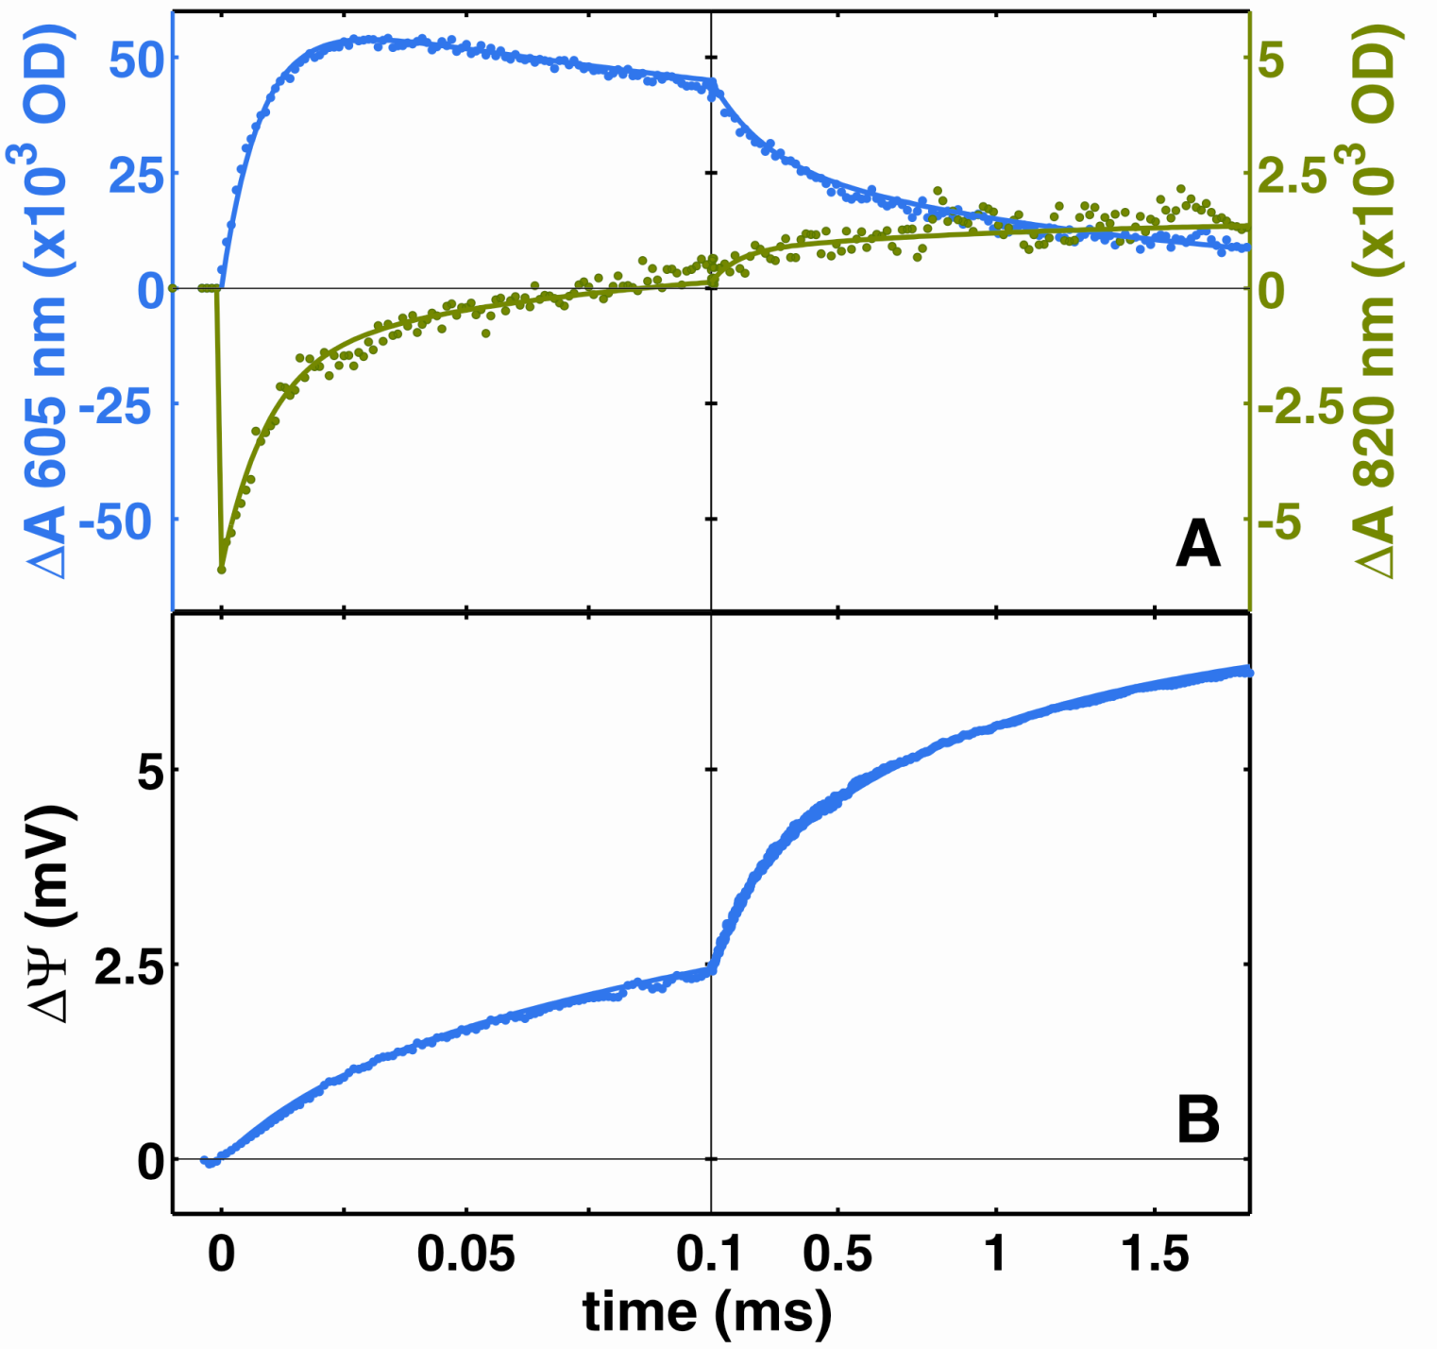
heme a
absorption kinetics
fitted to exponentials
with time constants
10 μs, 150 μs and
800 μs
Cu_{A}
ΔΨ fitted to
exponentials
with time constants
10 μs, 150 μs,
800 μs, and 2.5 ms

Slide 61

ELECTRON OCCUPANCY AND AMPLITUDE OF CHARGE
TRANSLOCATION FOR EACH KINETIC PHASE
FOLLOWING ELECTRON INJECTION
kinetic
phase
10 μs 150 μs 800 μs 2.5 ms
charge
translocation
0.24q
0.84q
0.60q
0.32q
electron
occupancy
(%)
Cu_{A}
30
0
0
0
heme a
70
39
0
0
binuclear
site
100
0
61
100

Slide 62
PROTON PUMP CYCLE BASED ON ELECTRON INJECTION INTO STATE O_{H}
e⁻
Cu_{A}
X
heme
a
heme
a₃
0
Cu_{B}
<0.5 μs
I
10 μs
II
H⁺
150 μs
VI
III
H⁺
2.5 ms
~1 ns
H⁺
V
0.8 ms
IV

Slide 63
PROTON PUMP CYCLE BASED ON ELECTRON INJECTION INTO STATE O_{H}
POPULATION
e⁻
30%
70%
Cu_{A}
E_{m} (Cu_{A}) 250 mV
E_{m} (heme a) 270 mV
X
heme
a
heme
a₃
0
Cu_{B}
<0.5 μs
I
10 μs
II
H⁺
150 μs
VI
III
40%
E_{m}(a) 390 mV
H⁺
2.4 ms
~1 ns
H⁺
60%
E_{m}(a₃) 400 mV
V
0.8 ms
IV

Slide 64
E_{m}
(mV)
pK(ox)
E_{m}(H⁺)
HEME a
E_{m}
e⁻
OX
RED
E_{m}(obs)
390 mV
pK(ox)
H⁺
pK(red)
H⁺
pK(red)
OX-H⁺
RED-H⁺
e⁻
270 mV (heme a)
E_{m}(H⁺)
E_{m}^{alk}
7
~9.0
pH

Slide 65
Assessment of pK value of X (pK^{r}) with center (heme a or a₃) reduced
e⁻
E_{m}^{pH} - E_{m}^{alk}
pK^{r} =
_____________
+ pH
60
0
I
II
H⁺
where
VI
H⁺
III
E_{m}^{pH} = E_{m} at pH=7
E_{m}^{alk} = E_{m} when X is unprotonated
H⁺
V
IV
E_{m} of heme a rises from 270 to 390 mV in the 150 μs phase (II->III+IV)
Consequently, the pK of X is raised by 120mV/60mV or 2 units above 7,
i.e. to pK ~9 in state III
E_{m} of heme a₃ must be ≤150 mV in states 0, I, and II, since the reduced
form is not populated significantly (error ~1%)
E_{m} of heme a₃ rises from ~150 mV to 400 mV in the 150 μs phase
Consequently, the pK of X is raised by 250mV/60mV or 4.2 units above 7,
i.e. to pK ~11.2 in state IV

Slide 66
PROTON PUMP CYCLE BASED ON ELECTRON INJECTION INTO STATE O_{H}
e⁻
Cu_{A}
pK^{r} ~9
X
heme
a
heme
a₃
0
Cu_{B}
<0.5 μs
I
10 μs
II
H⁺
150 μs
?
pK^{r} ~9
VI
III
?
H⁺
2.4 ms
~1 ns
H⁺
pK^{r} ~11.2
V
0.8 ms
IV

Slide 67
CATALYTIC CYCLE
(i) O₂ binding (formation of Compound A from R)
(ii) splitting of the O-O bond (formation of P_{M})
(iii) four consecutive one-electron steps with pumping
Electron donor (cytochrome c); E_{m} 0.270 V → 0.3 V
Electron acceptor (O₂); E_{m} 0.815 V → 0.8 V
Available free energy: 4 e * (0.8-0.3V) = 2.0 eV (46 kcal/mol)
This includes reactions (i) and (ii), where
(i) is essentially thermoneutral (ΔG ~0 kcal/mol) (Chance)
(ii) ΔG has been calculated to be ca. -3.6 kcal/mol (Blomberg & Siegbahn)
The four cycles of proton-pumping (iii) are assumed to be
equipotential with an average driving force of (46-3.6)/4 = 10.6 kcal/mol

Slide 68
ENERGY DIAGRAM WITHOUT PROTON-MOTIVE FORCE
Energy
kcal/mol
e⁻
15.0
12.9
0
I
II
H⁺
10
10.9
VI
H⁺
III
H⁺
4.6
V
IV
1.2
2.0
0
I
0.64
0.6
0
II
0
a ≥ 1.38(pK^{r}-pKº)
-2.2
-2.4
III
IV
b = 1.38(7-pKº)
a
a+b = 8.2 kcal/mol
-10
-9.4
b
pKº ≥ 6.1
V
-10.6
VI

Slide 69
PROTON PUMP CYCLE BASED ON ELECTRON INJECTION INTO STATE O_{H}
e⁻
pKº ~5.3
Cu_{A}
pK^{r} ~9
X
heme
a
heme
a₃
0
Cu_{B}
<0.5 μs
I
10 μs
II
H⁺
150 μs
pKº ~5.3
pK^{r} ~9
VI
III
pKº ~5.3
H⁺
2.4 ms
~1 ns
H⁺
pK^{r} ~11.2
V
0.8 ms
IV

Slide 70
Tentative identity of the pump site X
- suggested sites: the heme propionates (Michel), the δN of histidine 291
(Stuchebrukhov), and possibly a water cluster above the heme groups
- the effect of the electron at heme a or heme a₃ on the pK of X may help
this identification
- an electron at heme a increases the pK from 5.3 to 9.0 (3.7 pK units)
- an electron at heme a₃ increases the pK from 5.3 to 11.2 (5.9 pKunits)
ratio ~ 1.6
Conclusion (assuming homogeneous dielectric):
the ratio of 1.6 should correspond to the distance ratio X to heme a/X to heme a₃
i.e. X lies closer to heme a₃ than to heme a by a factor of ~1.6
Assuming that the heme iron is the "centre of charge change" on
oxidoreduction, both heme a propionates as well as the D-propionate
of heme a₃ are excluded because the distance ratio is < 1.1
The distance ratio for the δN of histidine 291 is 2.2
The distance ratio for the A-propionate of heme a₃ is 1.8!
e²
ΔpK=
_________
4πεε_{o}r k_{B}T

Slide 71
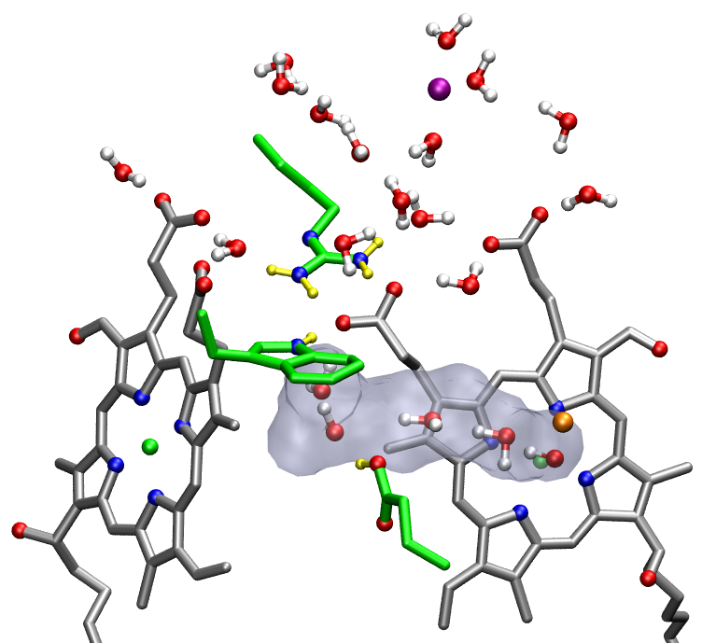
Mg
Nonpolar cavity
contains ca. 4 water
molecules that may
provide proton transfer
pathways from E-242
either via the D-propio-
nate of heme a₃
(pumping), or the
binuclear heme a₃/Cu_{B}
site (consumption)
R-438
A-propionate
W-126
D-propionate
heme a
heme a₃
Cu_{B}
E-242

Slide 72
Mean effective dielectric constant
- using the effects on the pK value of X from an electron in either
heme a or heme a₃, together with the actual distances from an
assumed pump site, yields an estimate of the dielectric constant
ε = 556/rΔpK (at T=300K and r in Ångströms)
if the pump site is taken to be the A-propionate of heme a₃ or the
δN of his-291 a dielectric constant of about 14 is obtained
- a dielectric constant of 14 is quite reasonable for the interior of a
protein

Slide 73
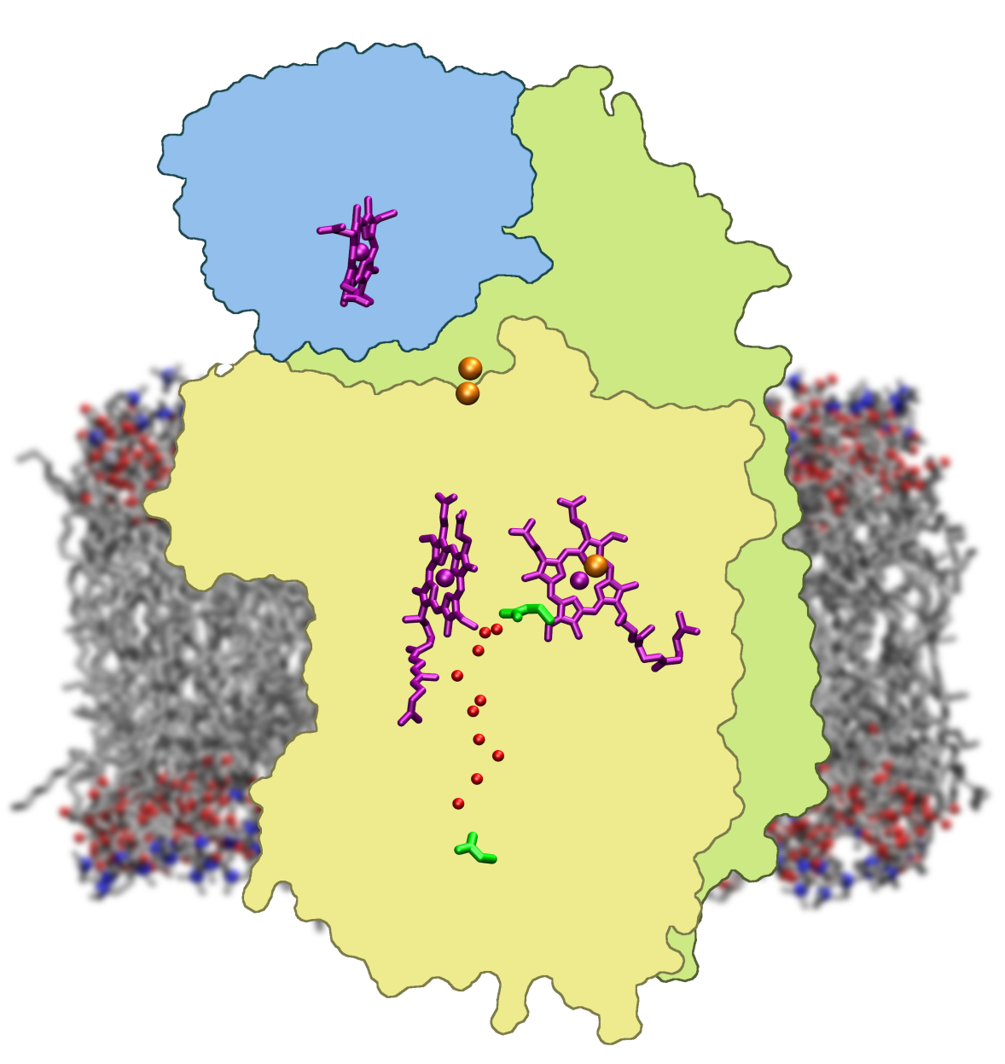
Reaction sequence
0
10 μs; ampl. 12%
150 μs; ampl. 42%
800 μs; ampl. 30%
2.5 ms; ampl. 16%
10%
36%
31%
23%
-0.2
-0.4
, relative units
-0.6
ψ
Δ
-0.8
-1
0
0.2
0.4
0.6
0.8
1
1.2
1.4
1.6
time,ms
10 μs; ampl. 100%
150 μs; ampl. 45%
800 μs; ampl. 55%

Slide 74
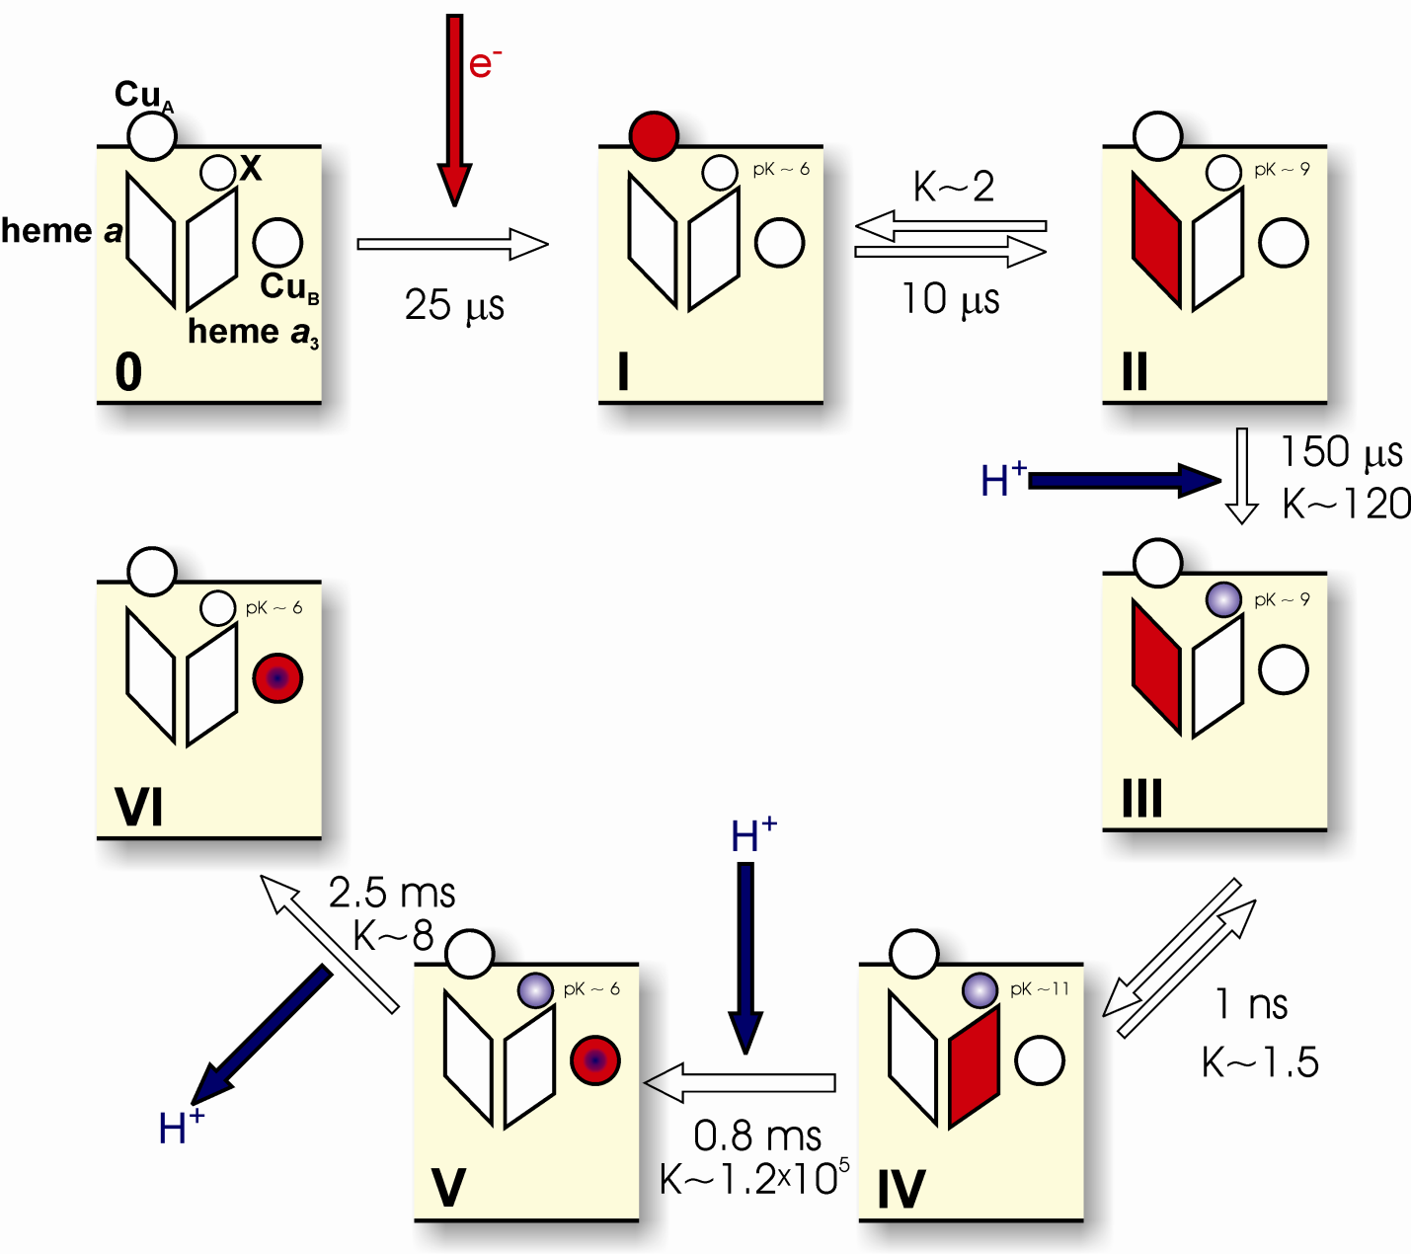
CONCLUSION

Slide 75






Proton translocation
by cytochrome c oxidase
Helsinki Bioenergetics Group
Structural Biology & Biophysics Programme
Institute of Biotechnology, University of Helsinki
Michael I. Verkhovsky
Dmitry Bloch
Ilya Belevich
Liisa Laakkonen
Ville R.I. Kaila
Nikolay Belevich

Slide 76

Gerhard Hummer
Laboratory of Chemical Physics
NIDDK, NIH, Bethesda

Slide 77

My grandchildren: Notice Aida’s healthy skepticism to what grand-dad says!
AIDA
OLIVER

Slide 78


Slide 80
ENERGY DIAGRAM WITH 170 mV MEMBRANE POTENTIAL
e⁻
Energy
kcal/mol
0
I
II
15.0
15.3
H⁺
14.3
11.6
VI
H⁺
III
10
H⁺
V
IV
5.1
2.0
2.0
2.3
2.0
1.2
II
III
IV
0
0
I
0
-2.4
-2.8
V
VI
-10

Slide 81

Visiting associate professor at the Johnson Foundation
in 1975-1976.

Slide 82
Energy barriers
From microscopic rate constants one can estimate the energy
barriers (free energy of activation) using transition state theory
- 10 μs phase barrier ca. 0.8 kcal/mol
- 150 μs phase barrier ca. 12.2 kcal/mol
- III->IV is pure electron tunnelling (~ 1 nanosecond)
barrier ca. 2.8 kcal/mol
- 0.8 ms phase barrier ca. 13.2 kcal/mol
- 2.6 ms phase barrier ca. 13.9 kcal/mol
OBS: Barriers ≥ ca. 16 kcal/mol must exist for alternative pathways
that do not lead to proton-pumping (leaks)

Slide 83

PMF(kcal/mol)
d(max)
[Å]

Slide 84
Basic chemistry of dioxygen reduction
(at neutral pH)
O₂^{.-}
superoxide
O₂..
(triplet state)
chemically inert
at ambient
temperature!
H₂O₂
peroxide
OH.
energy
hydroxyl radical
H₂O
H₂O
water
0
1
2
3
4
number of electrons

Slide 85

ISOMERISATION OF THE PROTONATED GLU-242 SIDE CHAIN

Slide 86

4 WATER MOLECULES IN CAVITY
GLU-242 INITIALLY "DOWN"

Slide 87

4 WATER MOLECULES
IN CAVITY
GLU "DOWN"
INITIALLY
Maximum likelihood analysis
S(t) = exp [-t/T]
If an event happens at t=T, S(t) is the probability that it has
not happened at time t
T~0.7 ns for "flip-up" of glu-242
side chain

Slide 88

0-4 WATER MOLECULES IN CAVITY
GLU-242 SIDE CHAIN INITIALLY "DOWN"

Slide 89

THE PREFERRED POSITION OF GLU-242 WITH
DIFFERENT WATER OCCUPANCY IN THE NON-POLAR
CAVITY
"up"
"down"

Slide 90

Glu-242 side chain dynamics with no water in the cavity
("flip-up" at 4.4 ns)
"up"
"down"

Slide 91
DYNAMICS OF THE GLU-242 SIDE CHAIN
CAVITY WITH 4 WATER MOLECULES
-mean flip-up time from X-ray position in 0.7 ns
-flip-down not observed
CAVITY WITHOUT WATER MOLECULES
-mean flip-up time from X-ray position in 4.4 ns
-mean flip-down time in 0.2 ns
X-RAY (down) POSITION IS FAVOURED BY
ΔG = kT ln K_{eq} = kT ln (4.4/0.2) = 1.85 kcal/mol (or ~ 3 kT)

Slide 92
CONCLUSIONS
=pK of pump site 9.0 (e⁻ at heme a) or 11.2 (e⁻ at heme a₃)
=the pump site is not a propionate of heme a, nor the D-prop
of heme a₃, but may be the δ-nitrogen of his-291 or the
A-prop of heme a₃
-the side chain of the protonated glu-242 isomerises between "up" and
"down" (X-ray) positions at ambient temperatures on a nanosecond time scale
-the "up" position is preferred energetically when there are 4 water
molecules in the non-polar cavity, but the "down" position is preferred
by ~3 kT if the cavity is "dry"
-the barriers for "up"/"down" are relatively small & consistent with
turnover
-the X-ray structures are "dry"; "resting enzyme"?

