Slide 1
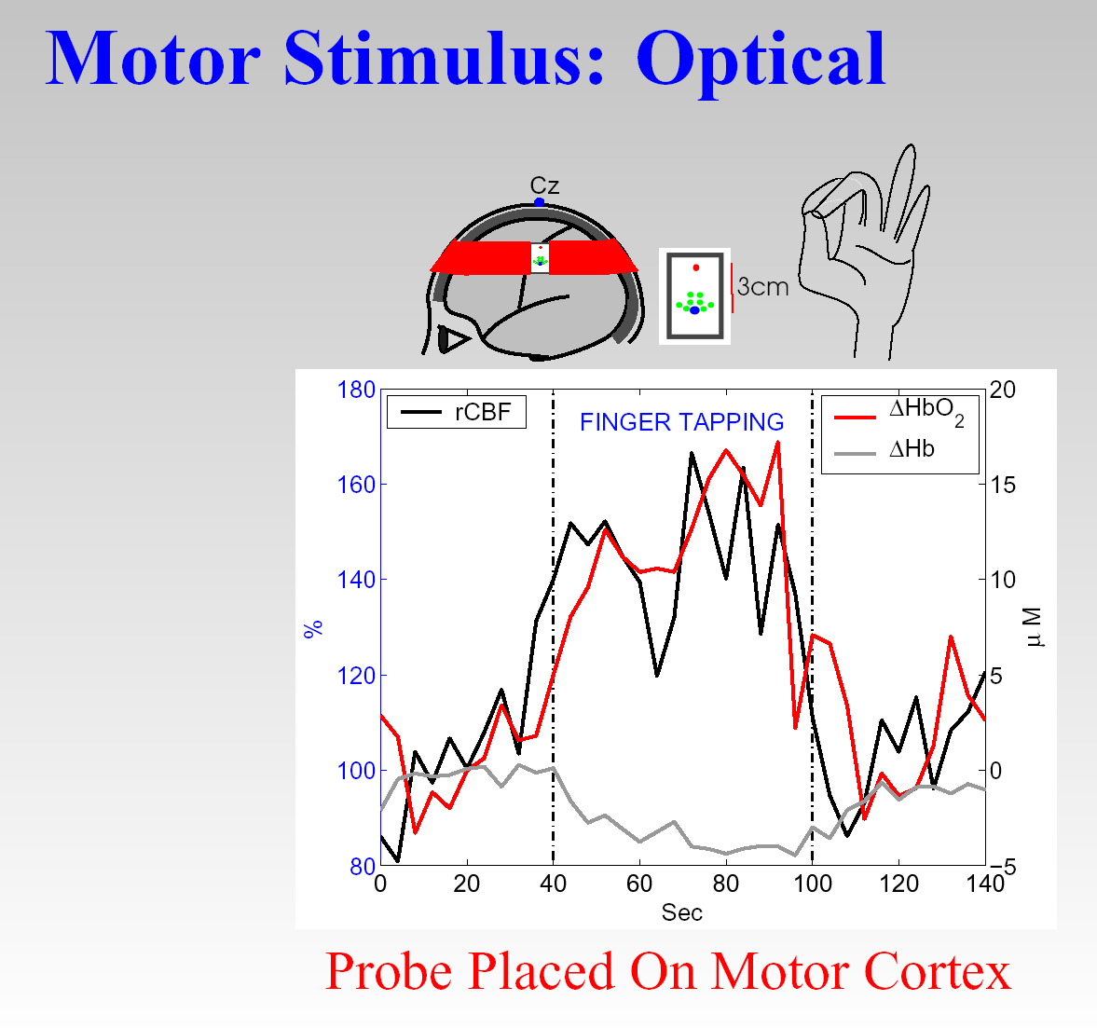
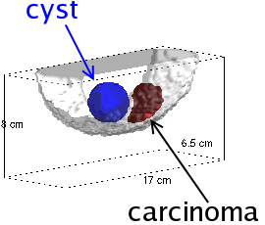
Learning about diffuse optics & its physiological applications with Britton Chance
Arjun G. Yodh
University of Pennsylvania
Department of Physics & Astronomy
30 co-authored papers
~1990-2010 (Britt, ~80-100 years-old; Arjun ~30-50)
Personal (myopic) account

Slide 2
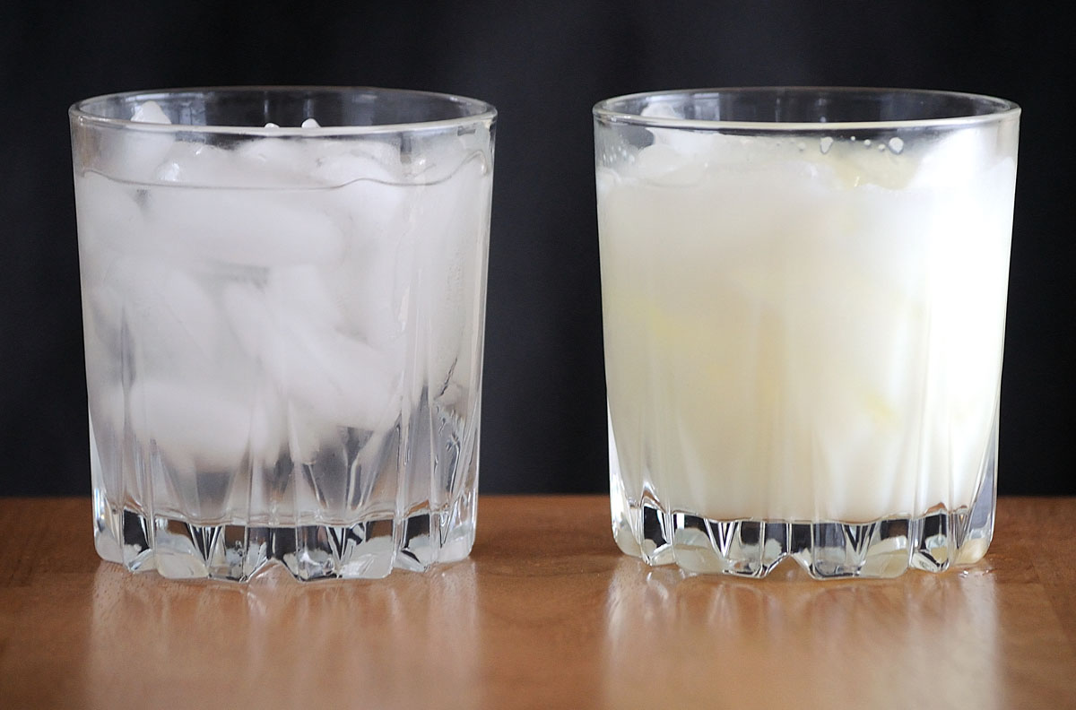
How do you look inside a glass of milk?
Ice in Water
Ice in Milk?

Slide 3
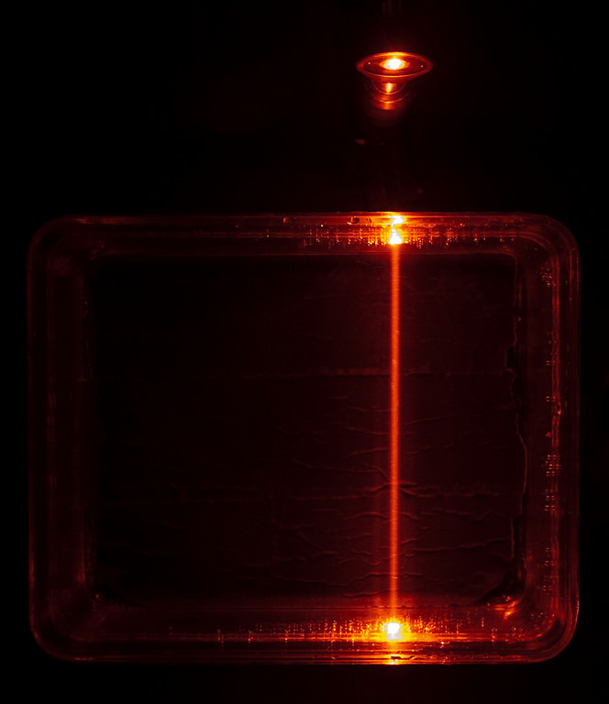
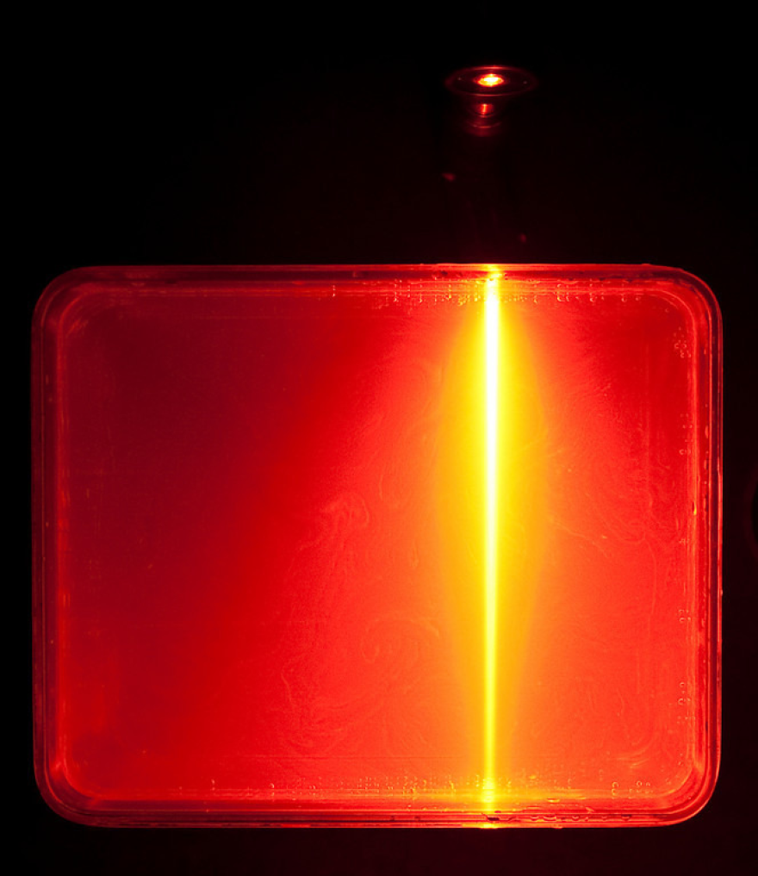
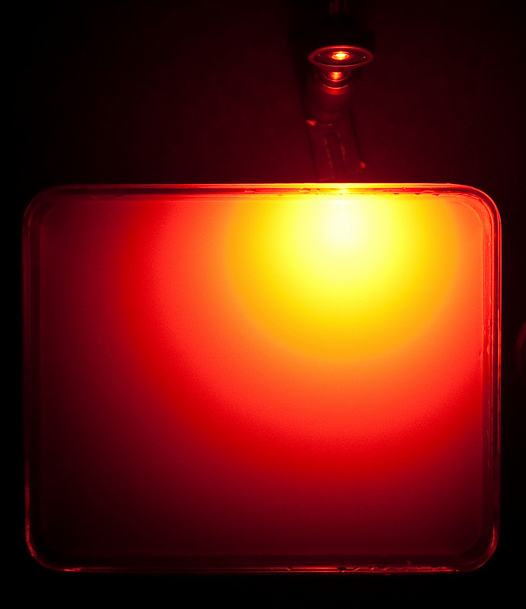
Why is this hard?
Water
Water + Little Milk
Milk
Light doesn’t get Absorbed, it Scatters

Slide 4
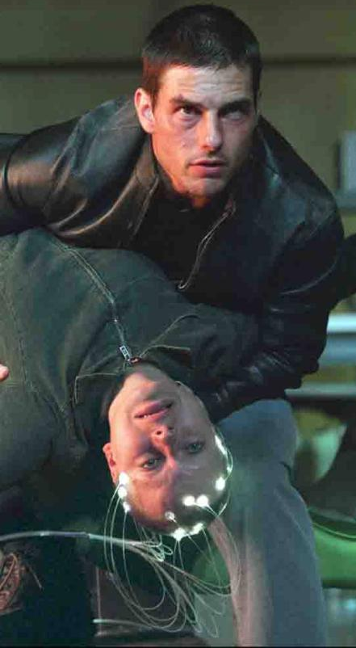
The Dream (Sci-Fi Community)
from: Star Trek
from: Minority Report

Slide 5
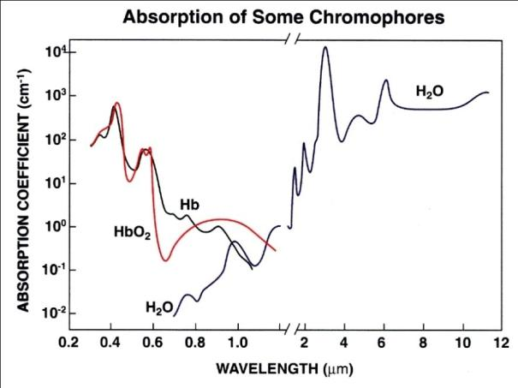
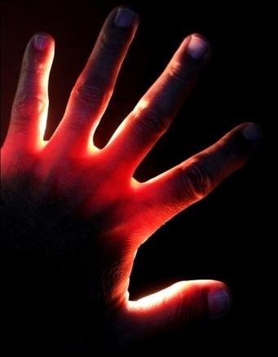
The Dream: Britton Chance
Near Infrared Light Penetrates Tissue
Non-invasive, safe, rapid, portable, continuous, inexpensive, ...

Slide 6
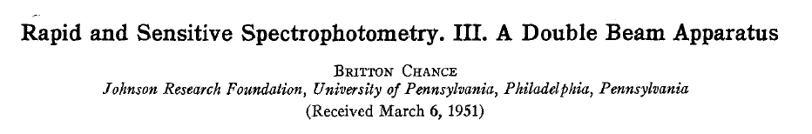
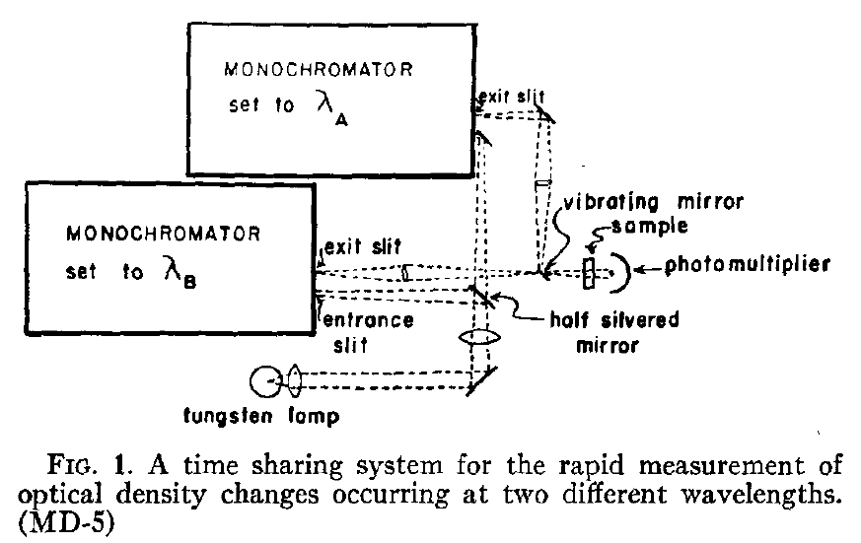
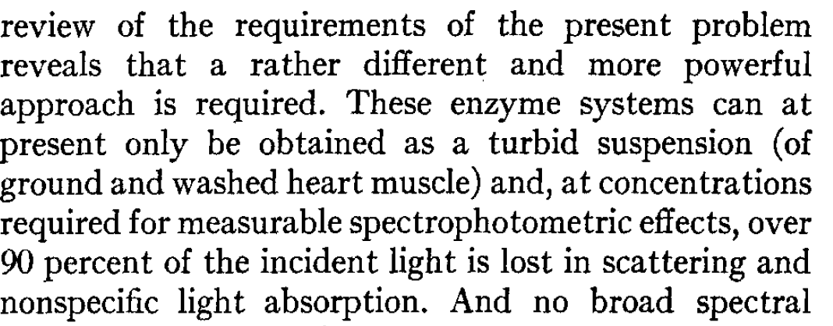
1951: Supressing Scattering in Biological Media

Slide 7
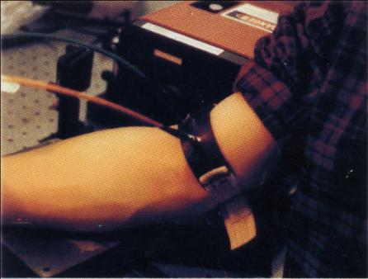
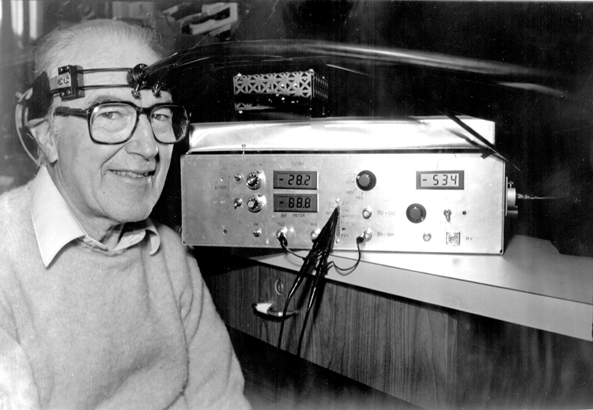
Britt Really Wanted to Measure Hemodynamics/Metabolic Processes in Living Tissue
Near Infrared Light Penetrates Tissue

Slide 8
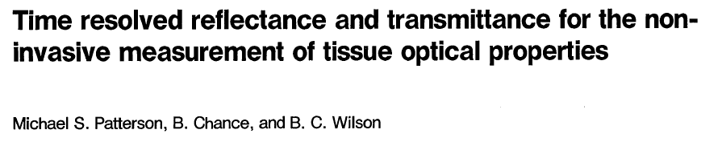
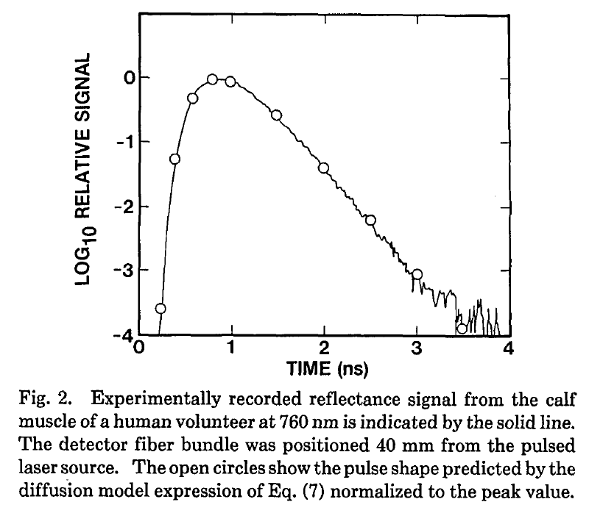
“Birth” of Diffuse Biomedical Optics
More than 1,000 citations.

Slide 9
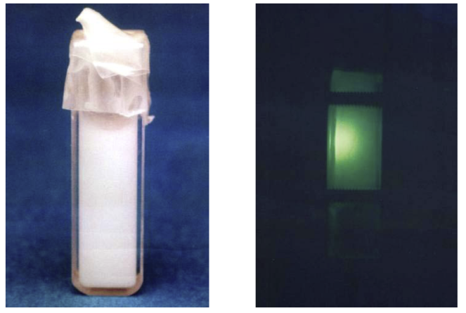
1988: Penn Physics Department
"Random" Walk
Brownian Motion in Concentrated Solutions.
(Diffusing-wave Spectroscopy)

Slide 10
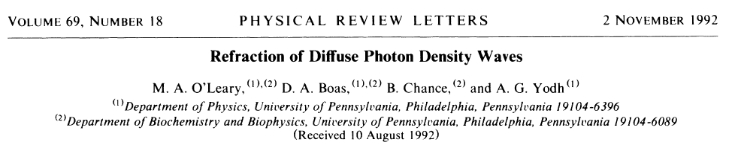
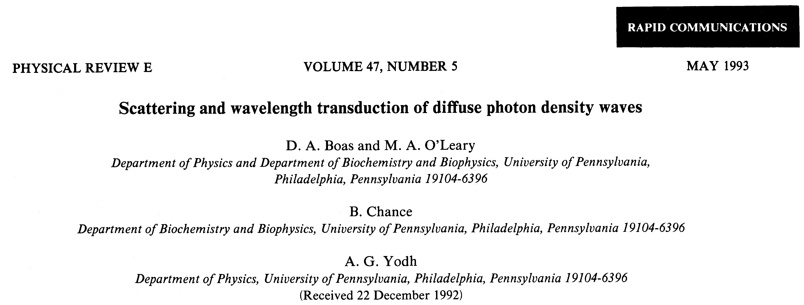
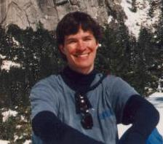
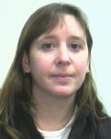
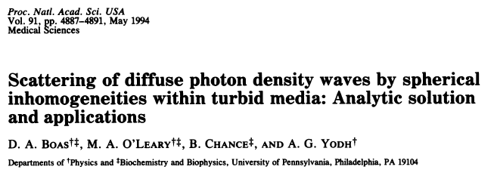
PhD Students!
David Boas
Maureen O’Leary

Slide 11
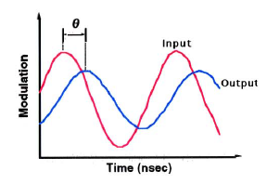
Diffusive Wave Optics
Boas, Oleary, Chance, Yodh. Physical Review E, 47(5) 1993.
Oleary, Boas, Chance, Yodh. Physical Review Letters, 69 1992.

Slide 12
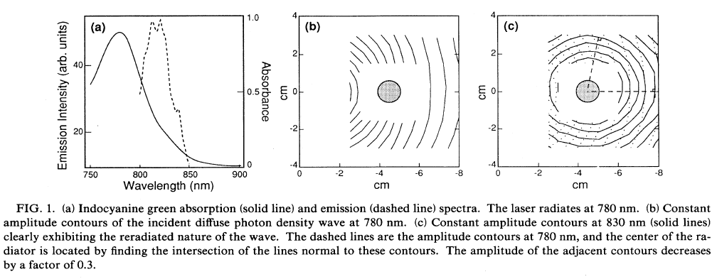
Fluorescence Objects in Turbid Media!

Slide 13
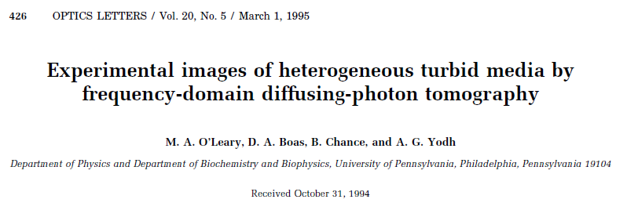
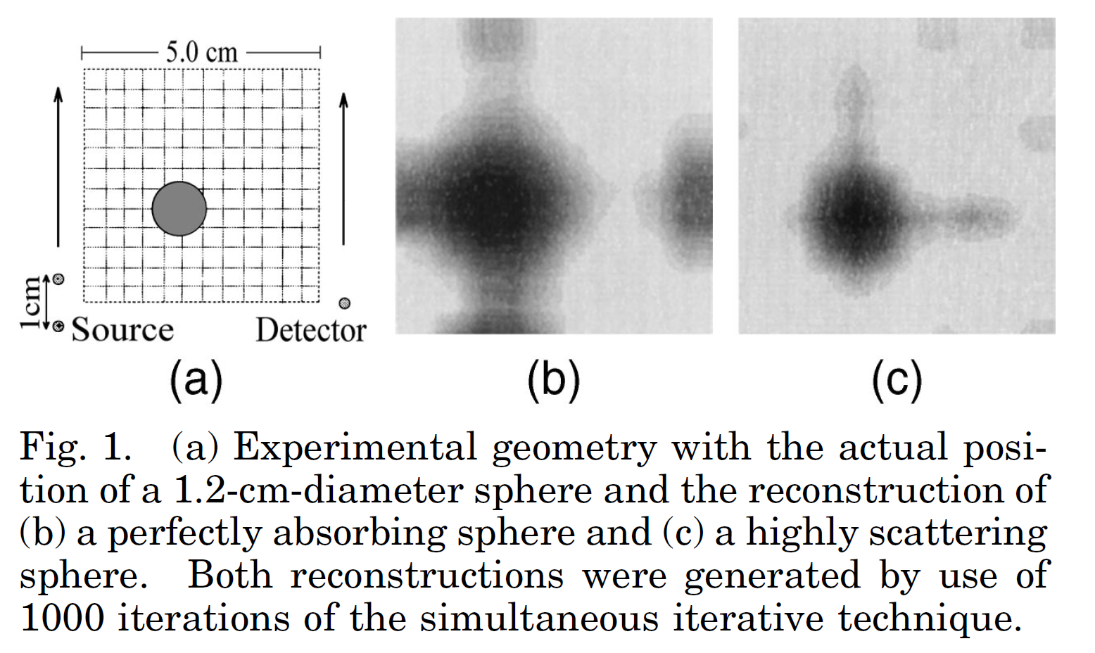
“First” Tomographic Imaging Experiments with Diffusive Waves
One Year Later, Fluorescence Concentration/Lifetime Tomography

Slide 14
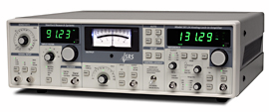
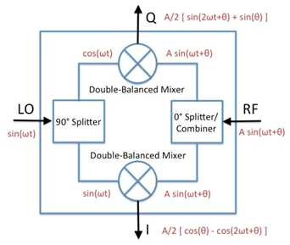
RF Electronics
Lock-In Amplifier (my solution, $2,000)
IQ-chip
(Britt's solution, $100)
IT'S BETTER TO KNOW WHAT'S INSIDE THE BLACK BOX.

Slide 15
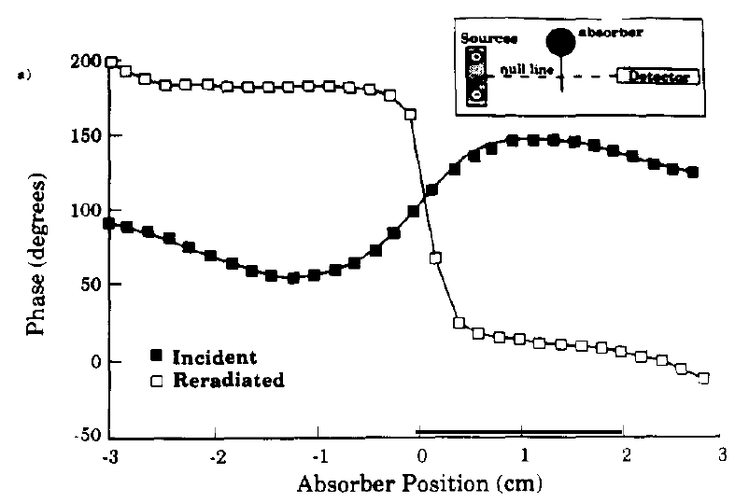
Other Diversions for Britt: Phase-Arrays
2010, still working on problem (persistence).

Slide 16
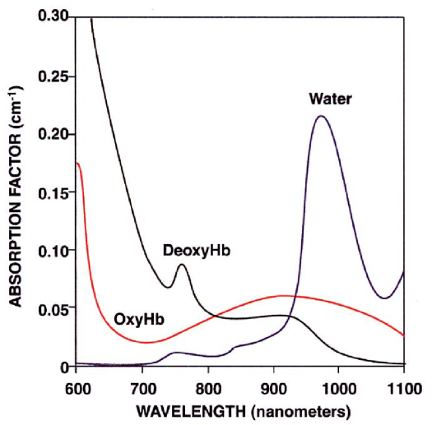
Living Things! Tissue Hemodynamics
Spectroscopy
Spectral Fingerprints enable determination of tissue composition.

Slide 17
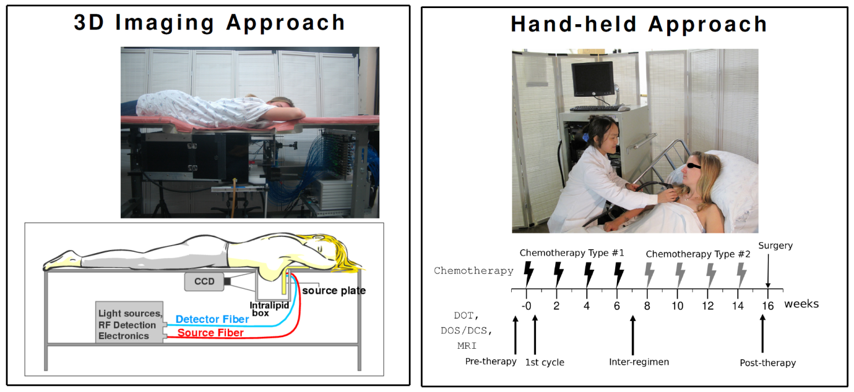
BREAST CANCER

Slide 18
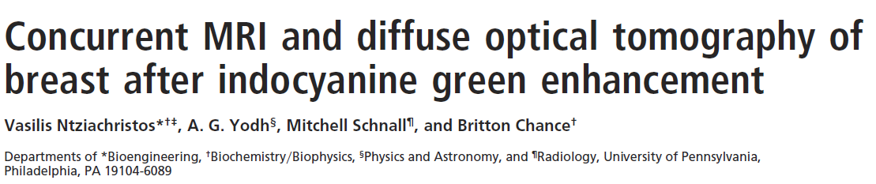
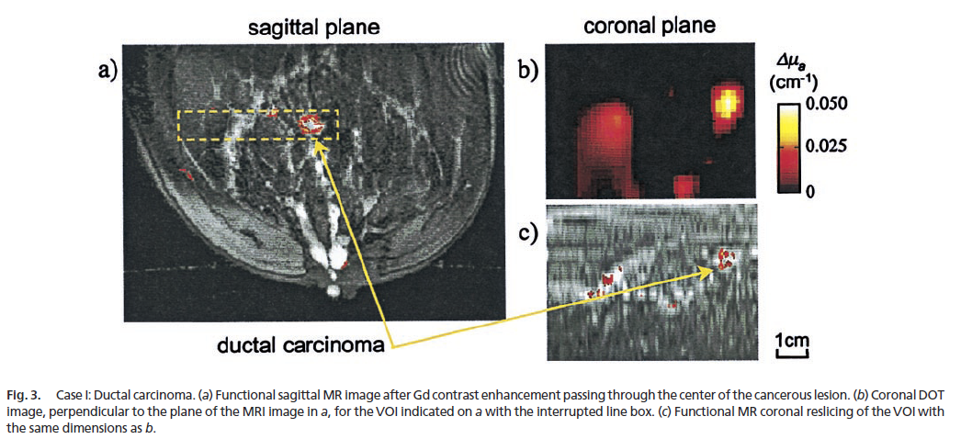
Combining Favorite Techniques: MRI + Optical (First Breast Cancer Studies)

Slide 19
Diffuse Optical Tomography of Breast

Slide 20
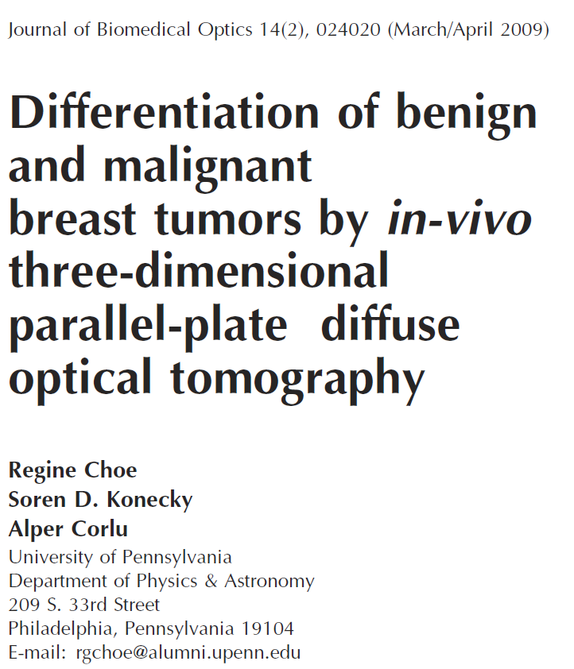

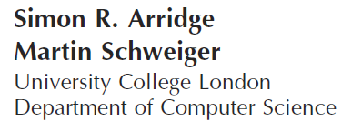
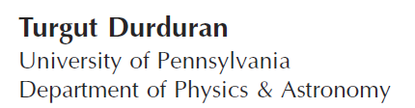
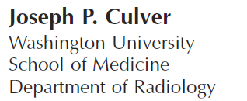
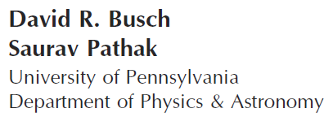
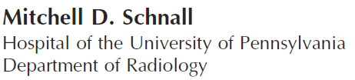
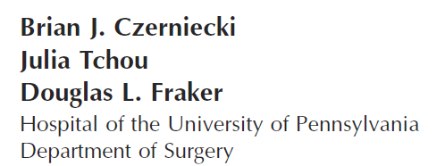
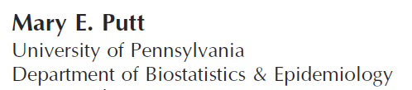
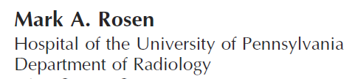
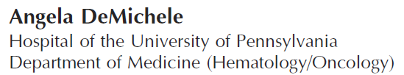
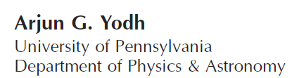
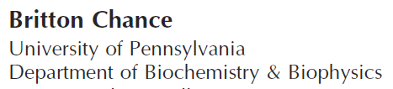
Differentiation Benign/Malignant

Slide 21
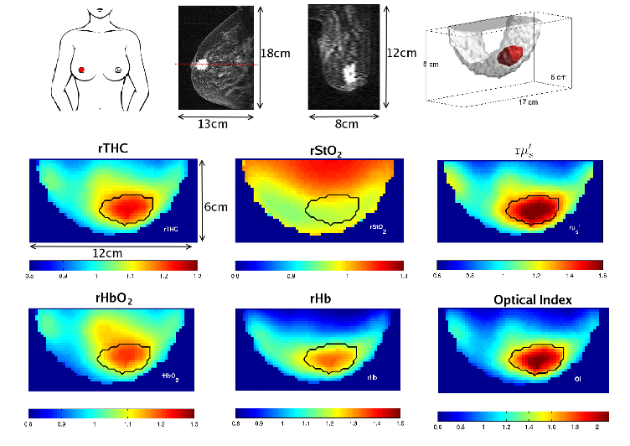
Invasive Ductal Carcinoma
rTHC – Hemoglobin
rStO₂ – Oxygen Sat.
rμʹ_{s} – Scattering
rHbO₂ – Oxyhemoglobin
rHb – Deoxyhemoglobin
53-year-old post-menopausal female, 2.2 cm invasive ductal carcinoma

Slide 22
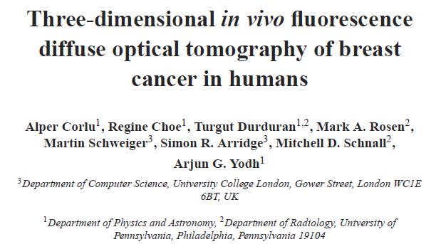
Fluorescence Diffuse Optical Tomography

Slide 23
Fluorescence Diffuse Optical Tomography (Large Contrast)
4-fold increase in ICG concentration.
Difference between hypervascularized
and leaky regions.
rTHC | rStO₂ | rμs’ | rICG
1.09 ± 0.03 | 0.91 ± 0.02 | 1.82 ± 0.93 | 3.74 ± 0.77

Slide 24
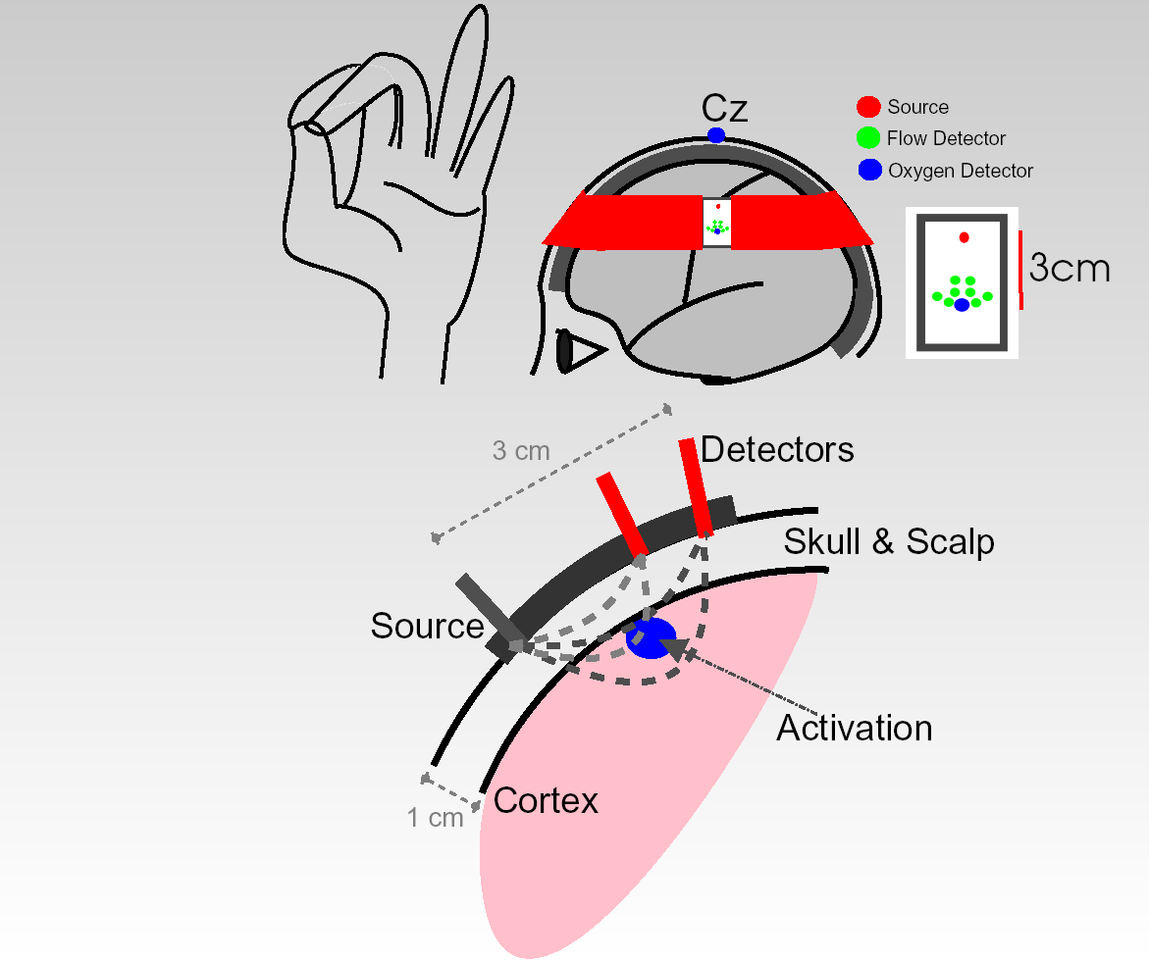
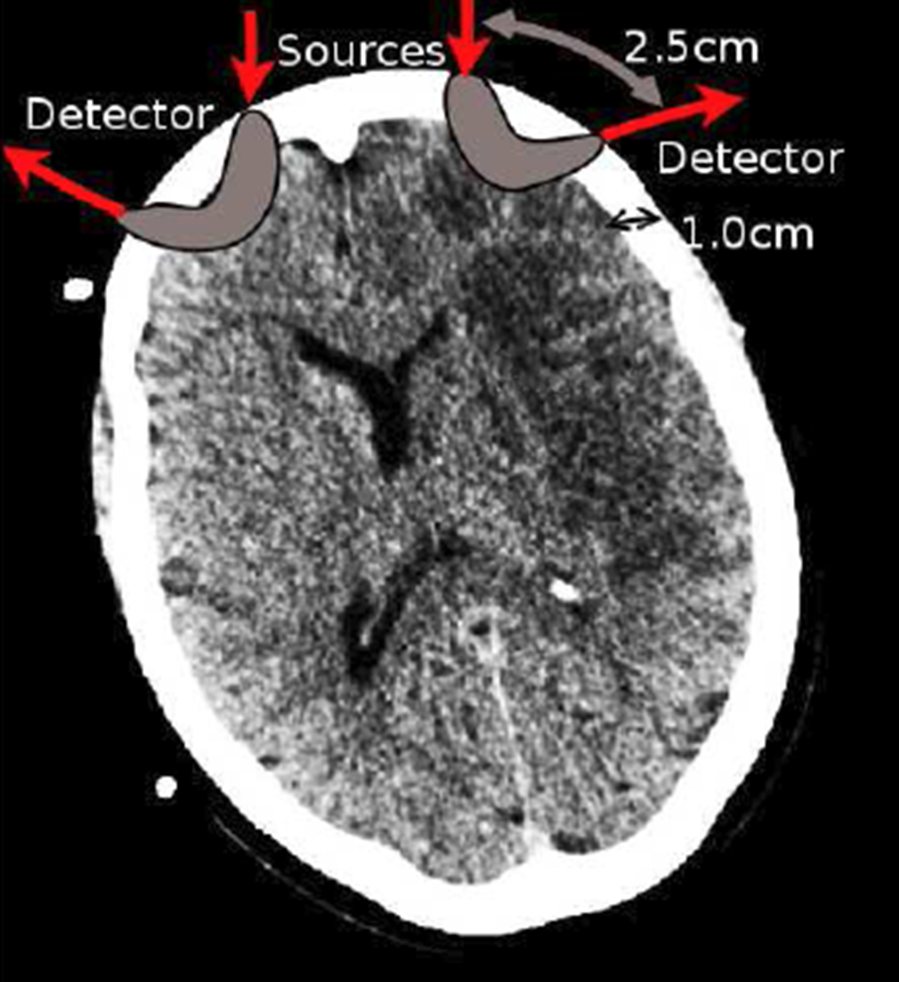
Inspiration from BC: Functional Activation In Brain
THC = Total Hemoglobin Concentration
StO₂ = Blood Oxygen Saturation
rBF = Relative Blood Flow
CMRO₂ = Rate of Cerebral Oxygen Metabolism

Slide 25
Motor Stimulus: Optical
Durduran, T., Yu, G., Burnett, M.G., Detre, J.A., Greenberg, J.H., Wang, J., Zhou, C., and Yodh, A.G., Diffuse optical measurement of blood flow, blood oxygenation and metabolism in human brain during sensorimotor cortex activation. Optics Letters 29, 1766-1768 (2004).

Slide 26
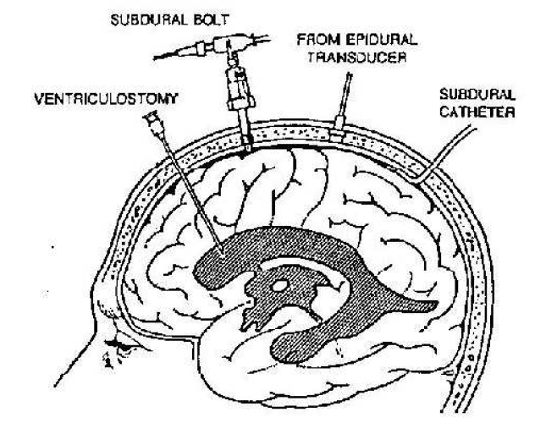
Realizing Britt’s Vision

Slide 27

Community Building
Organize, Organize, Organize, Workshops and Conferences
Promote, Promote, Promote young people, Penn
Pool Intellectual Property so scientists get a piece of the pie
Stay “focused” on the science (a marathon, not a sprint)
Competitive, but Collegial and Collaborative
Legacy: A Very Friendly & Productive Biomedical Optics Community.
with Bruce Tromberg

