Slide 1
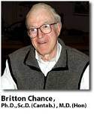
Mitochondrial NADH and Tissue viability In Vivo:
From Animal experiments to clinical Applications.
Avraham Mayevsky
The Mina and Everard Goodman Faculty of Life-Sciences and
The Leslie and Susan Gonda Multidisciplinary Brain Research Center
Bar-Ilan University, Ramat-Gan, 52900, Israel
Britton Chance: His Life, Times, and Legacy
University of Pennsylvania, Philadelphia, USA
June 3rd & 4th 2011
mayevsa@mail.biu.ac.il, mayevskya@gmail.com

Slide 2

The Book of Genesis
( Bible-Old Testament )
Chapter 1,3
“And God said, Let there be light: and there was light."
Chapter 1,4
“And God saw the light, that it was good: and God divided the light from the darkness.”

Slide 3
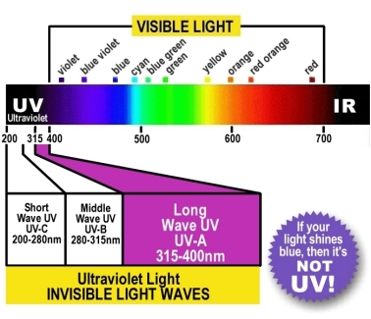
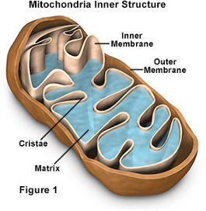
The created light is helping us to shed new light into the darkness of Mitochondrial Functions

Slide 4

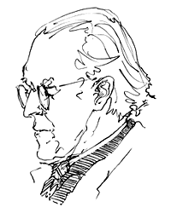
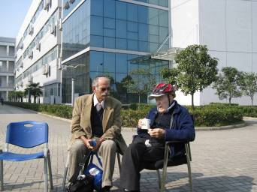
The use of light in studying mitochondrial function in vivo was introduced by my Post-Doc Mentor and teacher
Prof. Britton Chance more than 50 years ago

Slide 5
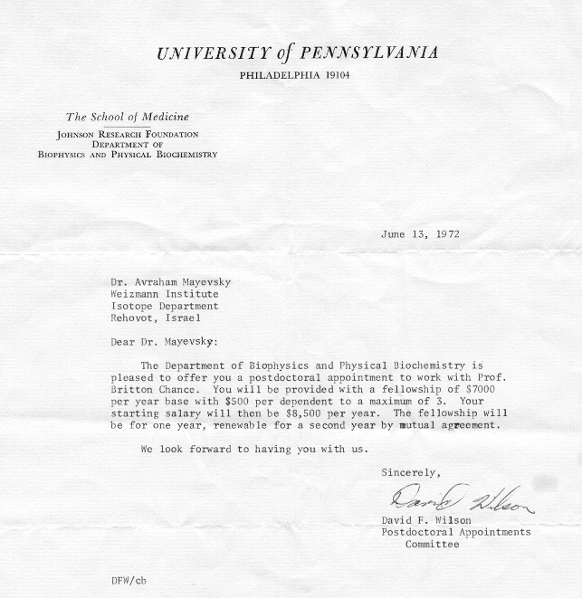
The letter that changed the scientific activities of my life

Slide 6
Short History –Monitoring of Mitochondrial function and Tissue Energy Metabolism.
“There is no instance in which it can be proven that an organ increases its activity under physiological conditions, without also increasing in its call for oxygen, and- in no organ excited by any form of stimulation can it be shown that positive work is done without the blood supply having to respond to a call for oxygen”.
Barcroft J. The Respiratory Function of the Blood.
Cambridge Univ. Press, Cambridge, 1914

Slide 7
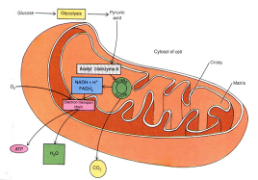

Supply
Tissue Energy
Balance
Demand
Tissue Blood Flow (LDF)
Arteriole
Typical Examples:
Mitochondrial NADH (Fluorometry)
O₂
O₂
O₂
Muscle Contraction
Brain Ionic Homeostasis
O
O
2
2
O₂
O₂
O₂
O
2
O₂
Hemoglobin
Oxygenation
(Oximetry)
Kidney Function
Gastrointestinal Activity
O₂
O₂
HbO₂
2
O₂
O₂
O₂
O₂
O
Glandular Secretion
2
Venule
ATP

Slide 8
Milestones in biophotonics of Mitochondrial NADH (1)
Year | Discovery | Author(s)
1905 | Involvement of adenine containing nucleotides in yeast fermentation | Harden & Young (1906)
1935 | Description of the complete structure of "Hydrogen transferring Coenzyme” in erythrocytes | Warburg et al (1935)
1936 | Definition of the two cofactors DPN and TPN | Warburg O (1949)
1951 | A shift in the absorption spectrum of DPNH with Alcohol dehydrogenase | Theorell & Bonnichsen (1951)
1951 | Development of a rapid sensitive Spectrophotometer | Chance & Legallias (1951)
Mayevsky and Rogatsky 2007

Slide 9
Milestones in Biophotonics of Mitochondrial NADH (2)
1952 | Monitoring of pyridine nucleotide enzymes | Chance
1957 | The first detailed study of NADH using Fluorescence spectrophotometer | Duysens & Amesz
1958 | Measurement of NADH fluorescence in isolated mitochondria | Chance & Baltscheffsky
1959 | Measurement of muscle NADH fluorescence in vitro | Chance & Jobsis
1962 | In vivo monitoring of NADH fluorescence from the brain and kidney | Chance et al
1965 | Comparison between NADH fluorescence in vivo and enzymatic analysis of tissue NADH | Chance et al.
1968 | Monitoring tissue reflectance in addition to NADH fluorescence | Jöbsis & Stansby
1971 | The first attempt to monitor the human brain during a neurosurgical procedure | Jöbsis et al.

Slide 10
Milestones in biophotonics of Mitochondrial NADH (3)
1973 | The first fiber optic based fluorometer-reflectometer used in the brain of an awake animal | Chance et al.; Mayevsky & Chance
1982 | Simultaneous monitoring of NADH in vivo in four different organs in the body | Mayevsky & Chance
1985 | Monitoring of brain NADH together with 31P NMR Spectroscopy | Mayevsky et al.
1991 | Simultaneous real time monitoring of NADH , CBF, ECoG, and extracellular ions in experimental animals and in the neurosurgical operating room | Mayevsky et al.
1996 | The multiparametric response (including NADH) to cortical spreading depression is for the first time measured in a comatose patient | Mayevsky et al.
2000 | Development of the FDA-approved “Tissue Spectroscope” medical device for real-time monitoring of NADH and tissue blood flow | Mayevsky et al.
2006 | Monitoring of tissue vitality (NADH, TBF and HbO2) by a new “CritiView“ device | Mayevsky et al.

Slide 11
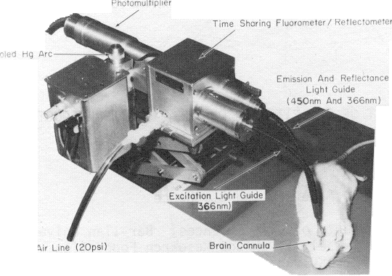
The first Fiber optic based Time-Sharing Fluorometer/Reflectometer
Mayevsky and Chance 1973

Slide 12
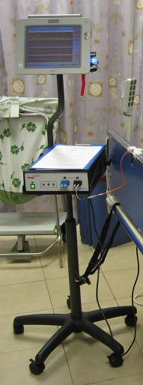
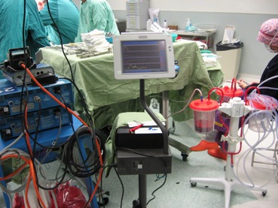
Clinical monitoring of NADH using the CritiView -2006
Operating Room
ICU
A dream came through

Slide 13
Mitochondrial Function and NADH fluorescence measurements
The definition of mitochondrial metabolic state in 1955, by Chance and Williams, opened up a new era in spectroscopic measurements of respiratory chain enzyme’s redox state In Vitro as well as In Vivo.

Slide 14
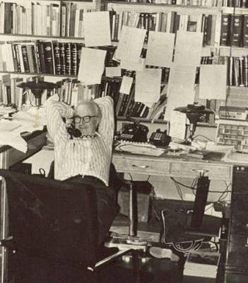
Why NADH ???
NADH Oxidation-Reduction State is the best parameter for evaluating Mitochondrial Function In Vivo
Chance et al in 1973 concluded that “For a system in a steady state, NADH is at the extreme low potential end of the chain, and this may be the oxygen indicator of choice in isolated mitochondria and tissues as well.”
Chance, B., Oshino, N., Sugano, T., Mayevsky, A., 1973. Basic principles of tissue oxygen determination from mitochondrial signals. In: Internat. Symposium on Oxygen Transport to Tissue, Adv. Exp. Med. Biol. Vol.37A, pp.277-292. Plenum Pub Corp, New York,

Slide 15
Scientific background underlying NADH fluorescence measurements
Principles of Tissue Energy Metabolism In Normal cells

Slide 16




Oxygen Gradients from AIR to Mitochondria
160
O₂
N₂
End Tidal
CO₂
Oxygen Partial Pressure (mmHg)
150
Heart Rate &ECG
Cardiac Output
100
95
Systemic Blood Pressure
100
Systemic Saturation
(Pulse Oximetry)
CritiView
Microcirculation blood flow and oxygenation
NADH redox state
50
20-30
1
0
AIR
Alveoli
Arterial Blood
Tissue
Intramitochondrial

Slide 17
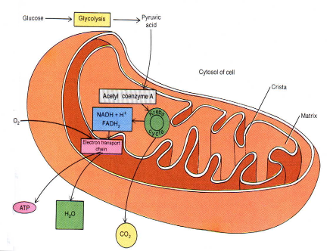
The Mitochondrion
The NADH molecule is a control marker in the energy generation chain in the mitochondria
An increase in the NADH levels indicates that metabolic imbalance unfolds

Slide 18
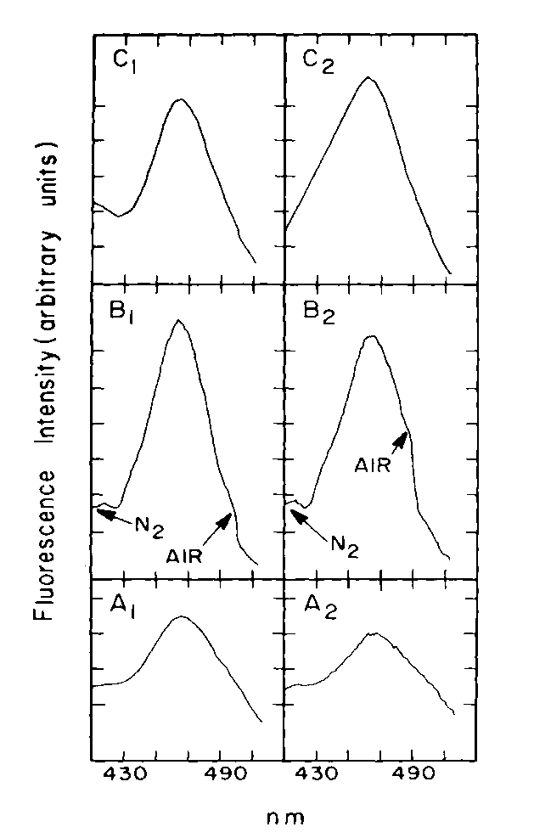
A. NADH - The Mitochondrion “Flag”
C. NADH Fluorescence spectra
B. Absorption Spectra of NAD⁺ and NADH
nm
Am. J. Physiol. Cell Physiol. 292: C615-C640 (2007).

Slide 19
NADH Calibration in Solution

Slide 20
Methods and Technology used in the past and current state of art
From Single parameter to multiparametric monitoring approach

Slide 21
Science, 137:499-508, 1962

Slide 22
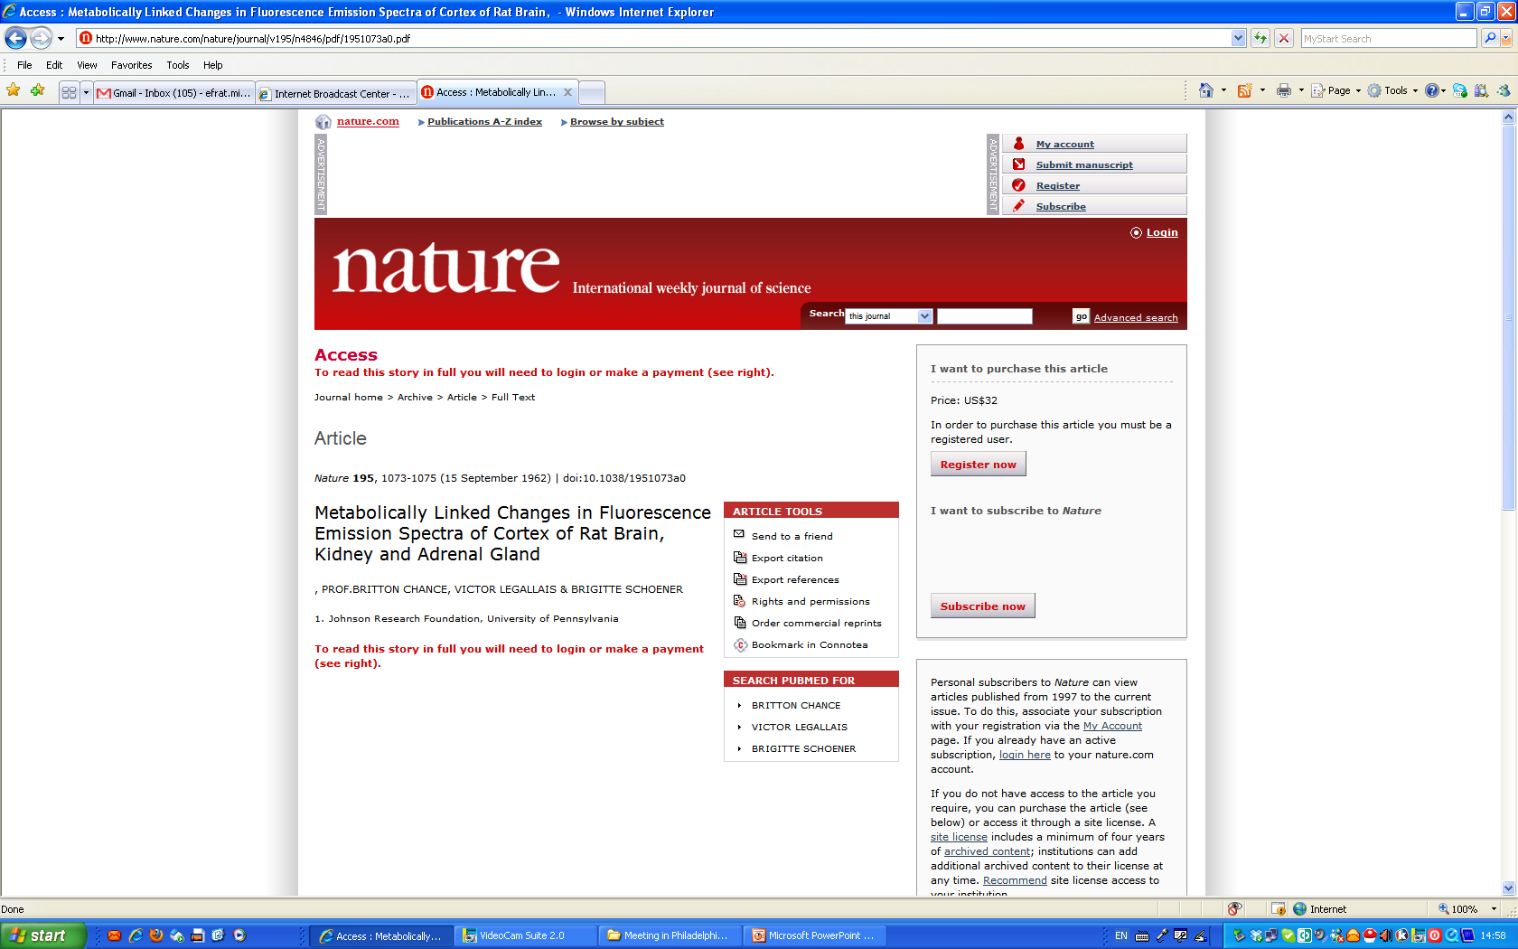
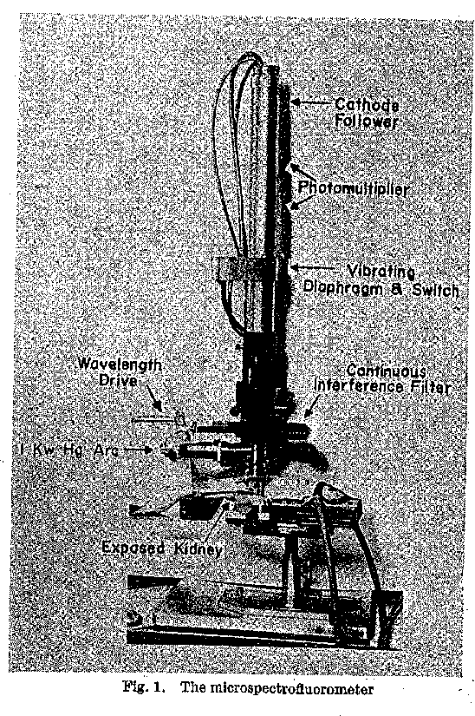

Slide 23
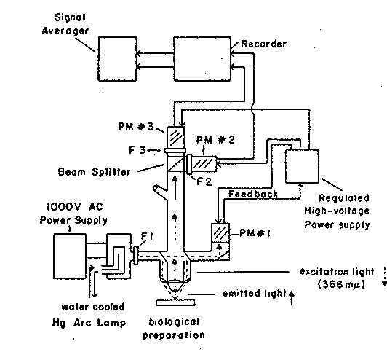
B.Chance Fluorometer 1960th
F.F. Jobsis Group Fluorometer 1970th

Slide 24
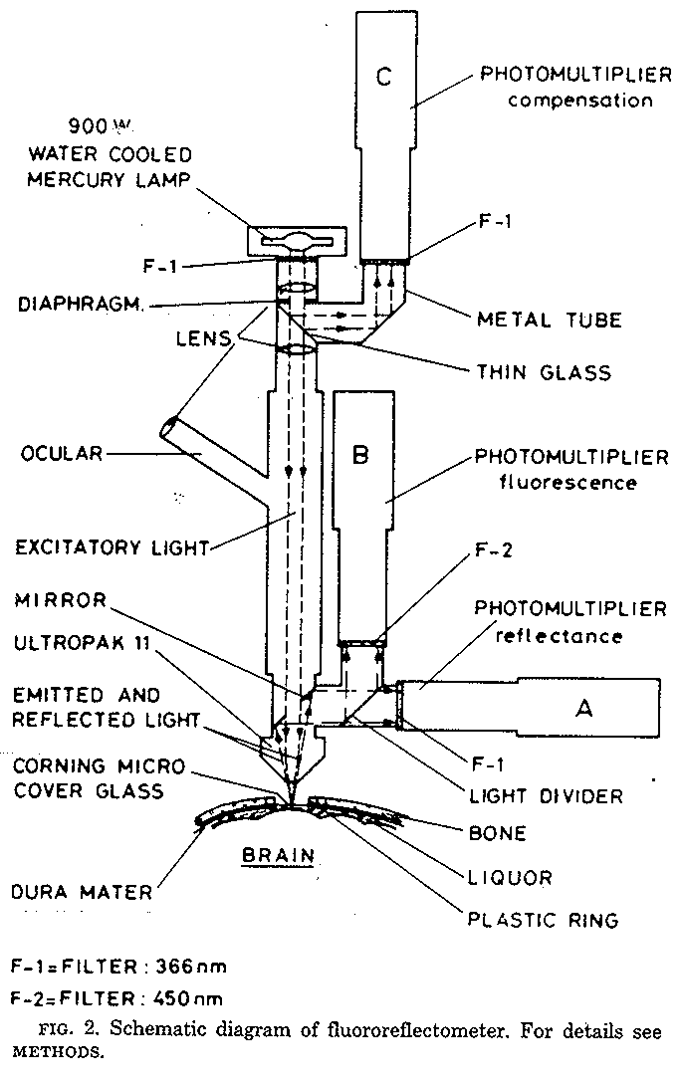
Am. J. Physiol 243: H619-627 (1982)

Slide 25
Various Types of Fluorometers Developed During 1970-1980
Mayevsky A. Brain Res. Rev. 7: 49‑68, (1984).

Slide 26
Effects of Anoxia (100% Nitrogen) - Brain

Slide 27
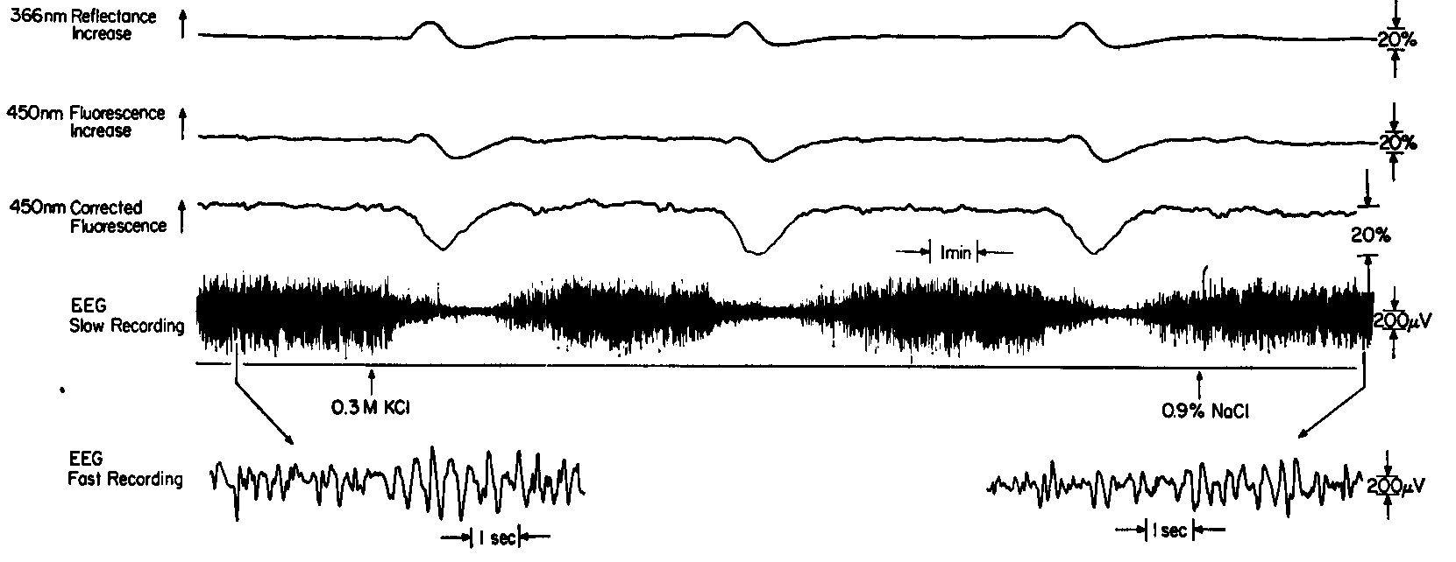
Effects of Cortical Spreading Depression on Brain NADH
NADH Oxidation

Slide 28
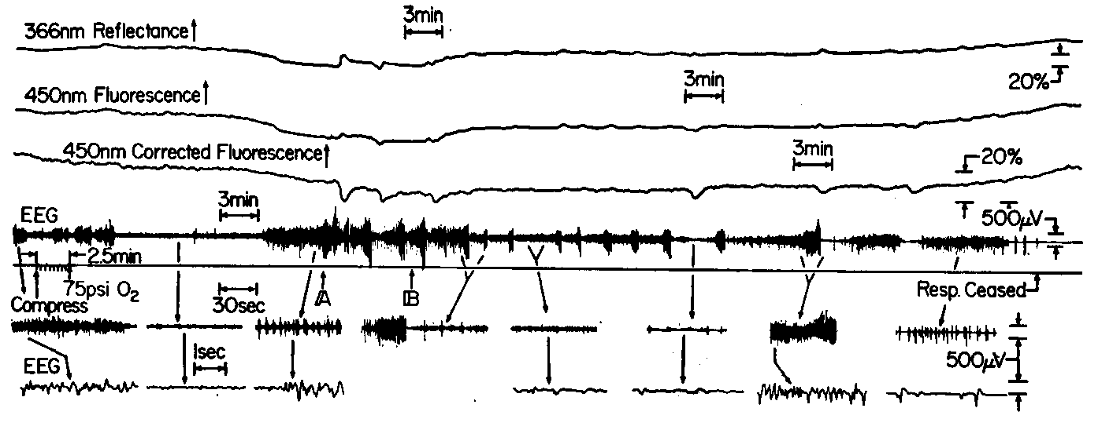
Effects of Hyperbaric Oxygenation on brain NADH and EEG
A. Mayevsky, D. Jamieson and B. Chance, Brain Res. 76, 481-491 (1974).

Slide 29
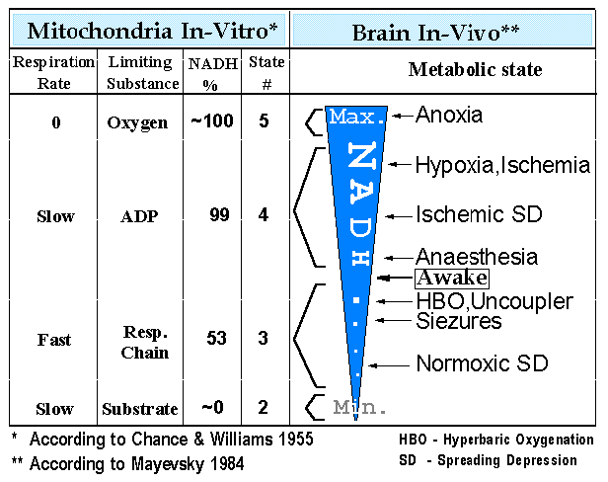
Mitochondrial Redox state In Vitro and Brain NADH Responses In Vivo

Slide 30
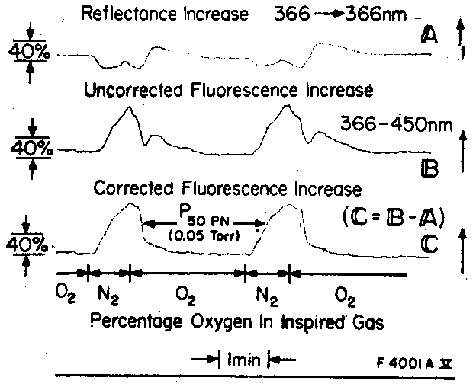
A
B
B. Chance, A. Mayevsky, C. Goodwin and L. Mela, Microvasc. Res. 8, 276-282 (1974).

Slide 31
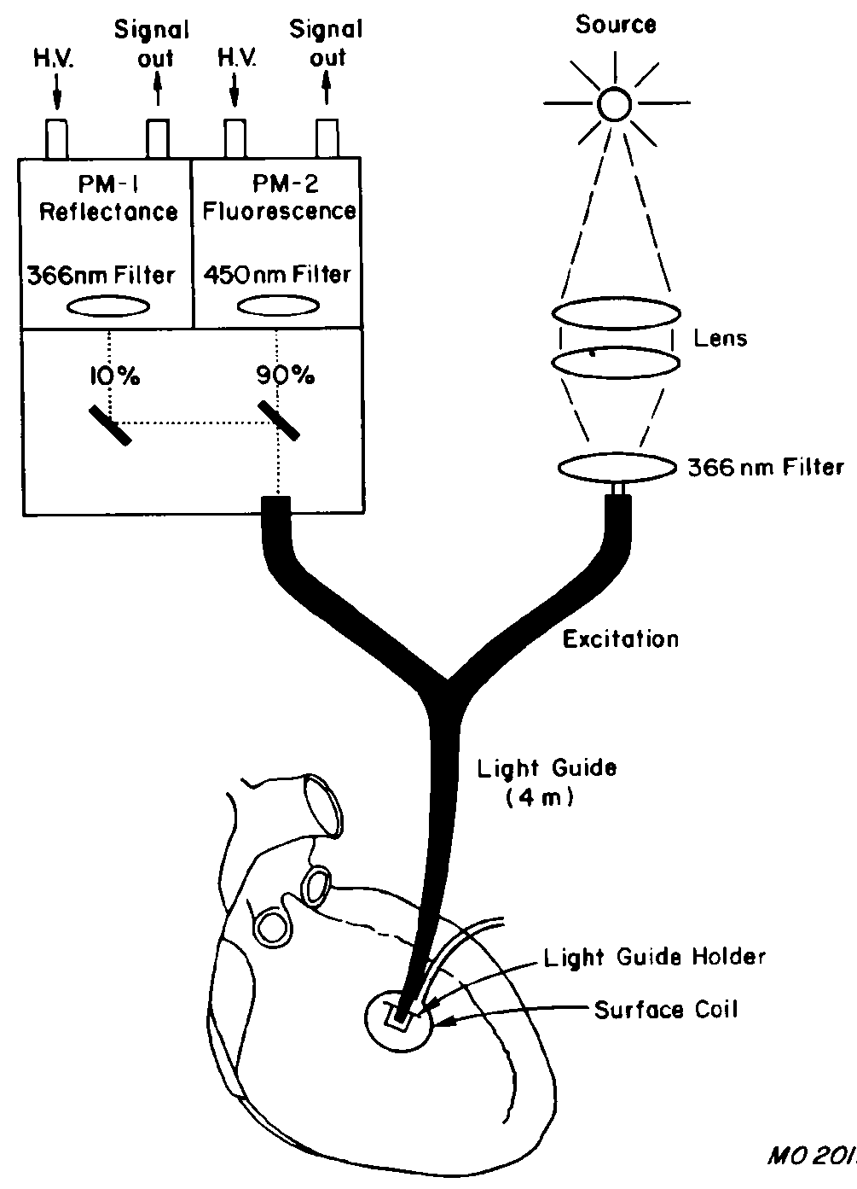
Monitoring the Beating Heart In Vivo
Diagram of the light guide, used in conjunction with a fluorometer built in our laboratory, and the surface coil on heart. HV = high voltage, PM = photomultiplier tubes.
M Osbakken et al
J. Appl. Cardiol. 4: 305‑313 (1989).

Slide 32
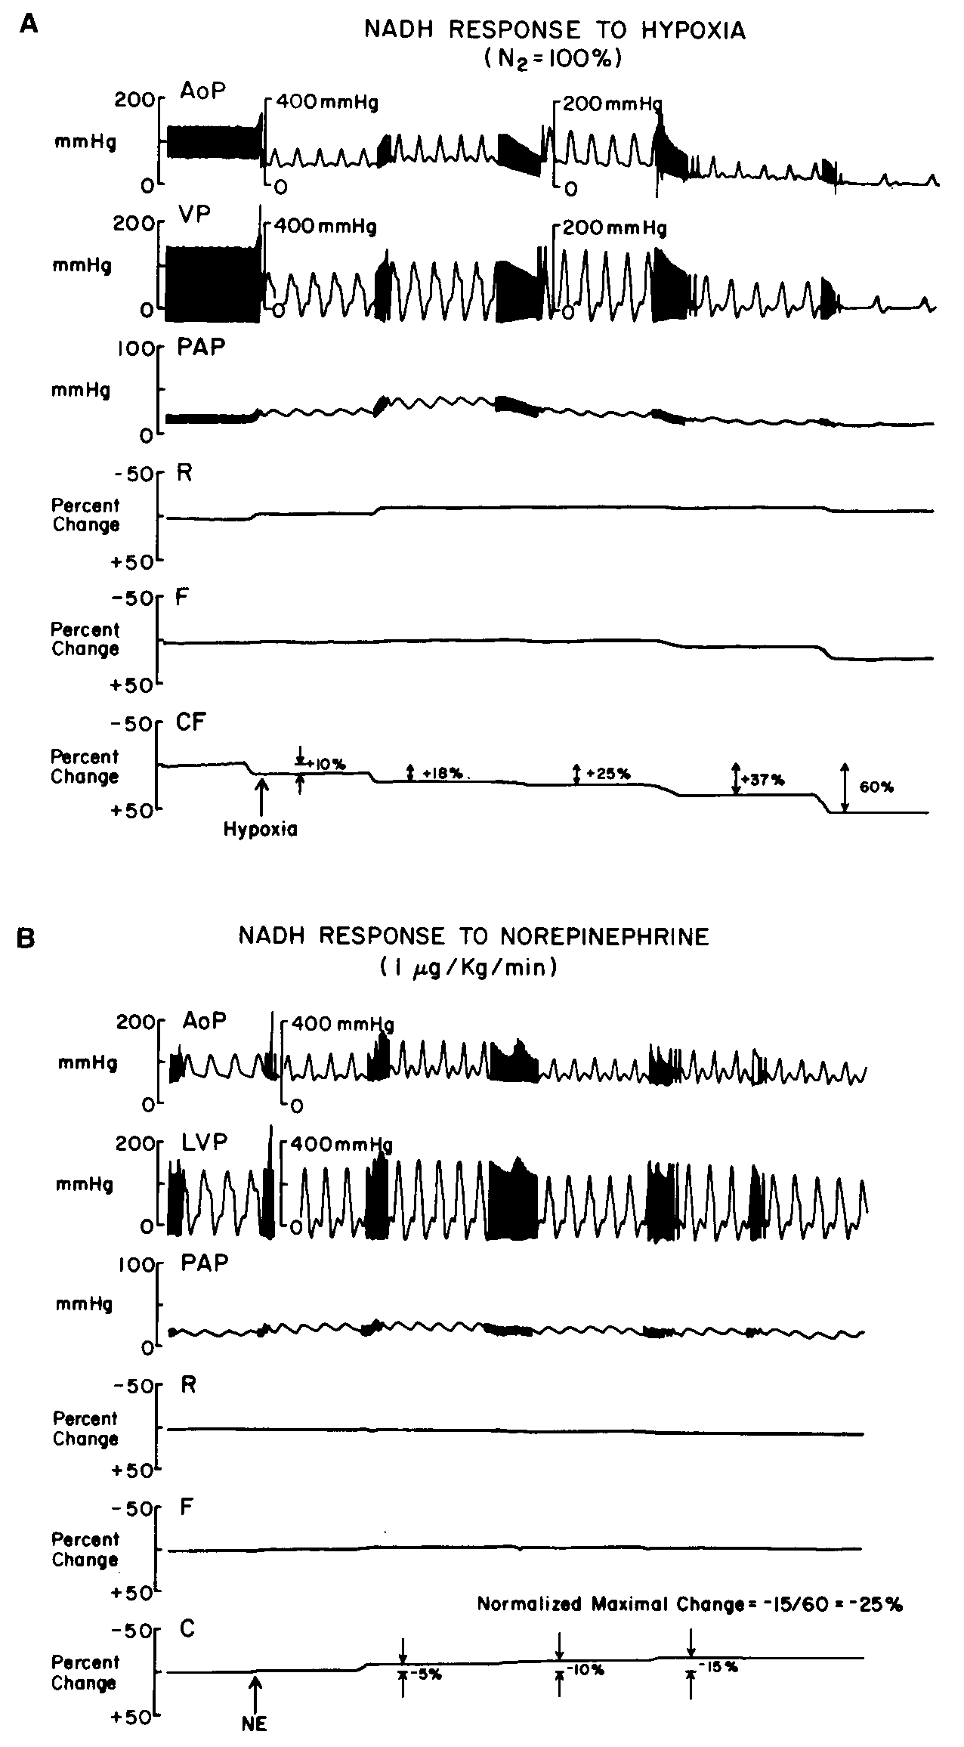
Typical NADH responses of dog myocardium during (A) hypoxia and (8) pressure loading. AOP = aortic pressure, CF = corrected fluorescence. F = fluorescence, PAP = pulmo- nary artery pressure, R = reflectance, VP = ventricular pressure. Note that the NADH response to norepinephrine was related to maximal NADH response to hypoxia (in this case, anoxia produced by using 100% inspired N2.
J. Appl. Cardiol. 4: 305‑313 (1989).

Slide 33
Low Temperature Scanning of NADH and Fp in Frozen Tissues
Chance et al 1978

Slide 34
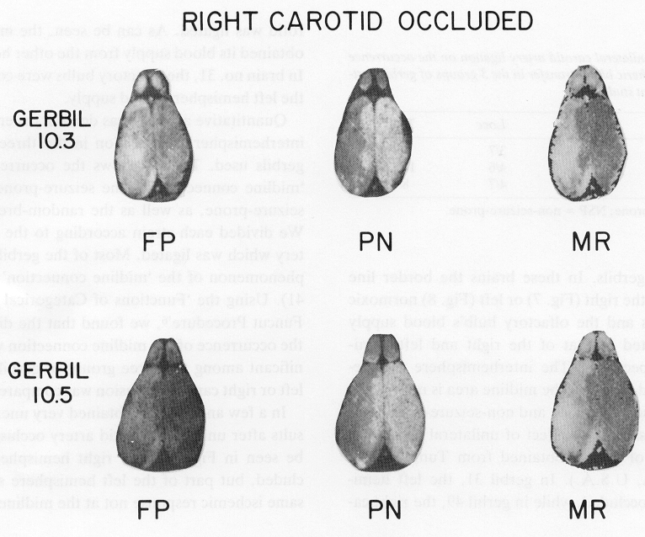
Scanning of NADH and Fp in the Partial Ischemic Brain
Effects of right carotid occlusion on the redox states measured in two brain depths.
Brain Res. 367: 63-72 (1986).

Slide 35
Multichannel Monitoring of NADH Redox State In Vivo
Fig. 3. Four-channel DC fluorometer/reflectometer connected to the gerbil brain using a flexible fiber optic bundle (for details see text).
Brain Res. Rev. 7: 49‑68, (1984).

Slide 36
Multiorgan Monitoring of NADH Redox State in the Rat
Brain
Liver
Kidney
Testis
(A) Effects of graded hypoxia and anoxia on the NADH redox state in an artificially,--- ventilated rat. Four organs were monitored simultaneously, and for each organ we recorded the reflectance (R) and the corrected fluorescence (CF). Subscripts: B, brain; L, liver; K, kidney; and T, testis. (B) Effects of asphyxia.
Science 217, 6 August ,1982.

Slide 37
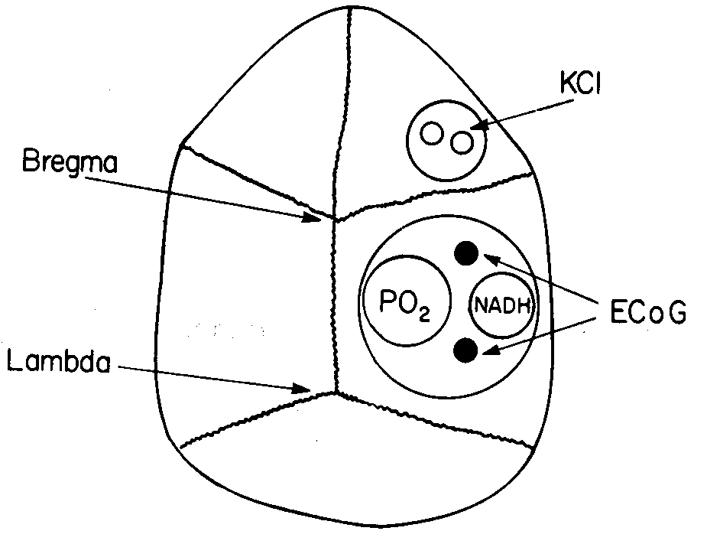
A. Mayevsky, S. Lebourdais and B. Chance, J. Neurosci. Res. 5, 173-182 (1980).

Slide 38
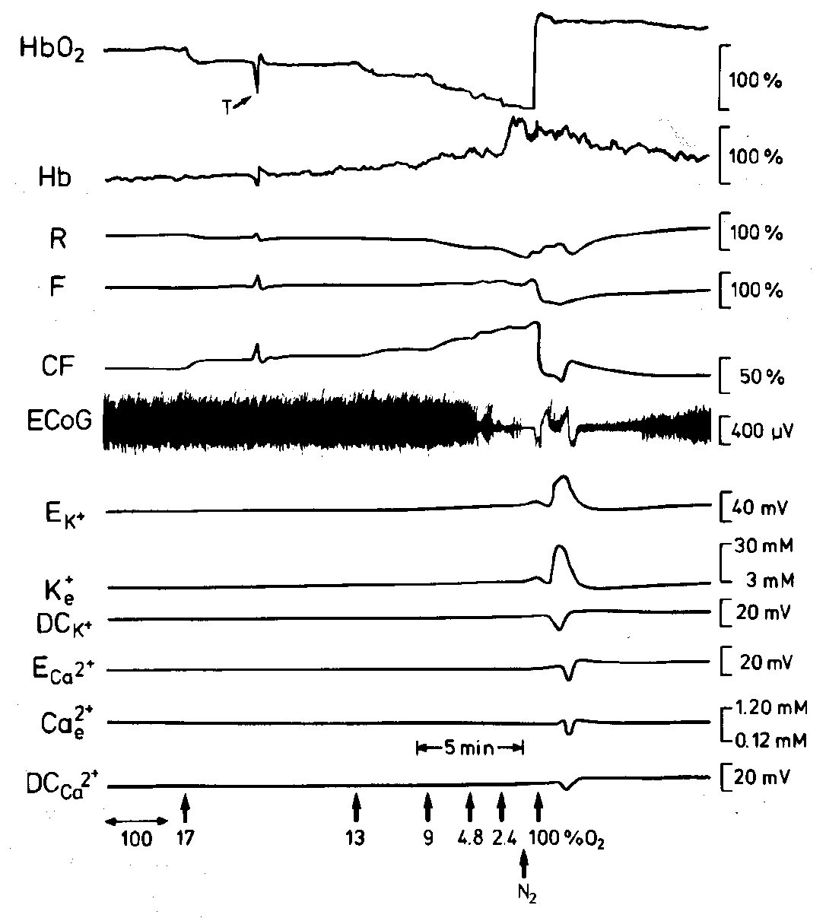
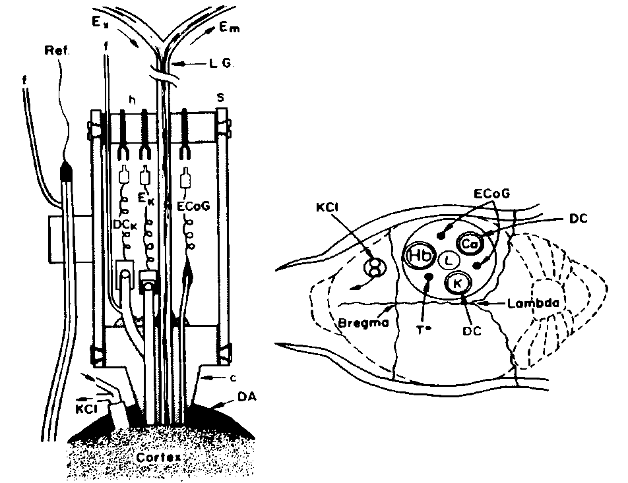
A
B
A. Mayevsky, K. H. Frank, S. Nioka, M. Kessler and B. Chance, in Oxygen Transport to Tissue XII, J. Piiper, T. K. Goldstick, M. Meyer, Eds., pp. 303-313, Plenum Press, (1990).
A. Mayevsky, D. Jamieson and B. Chance, Brain Res. 76, 481-491 (1974).

Slide 39
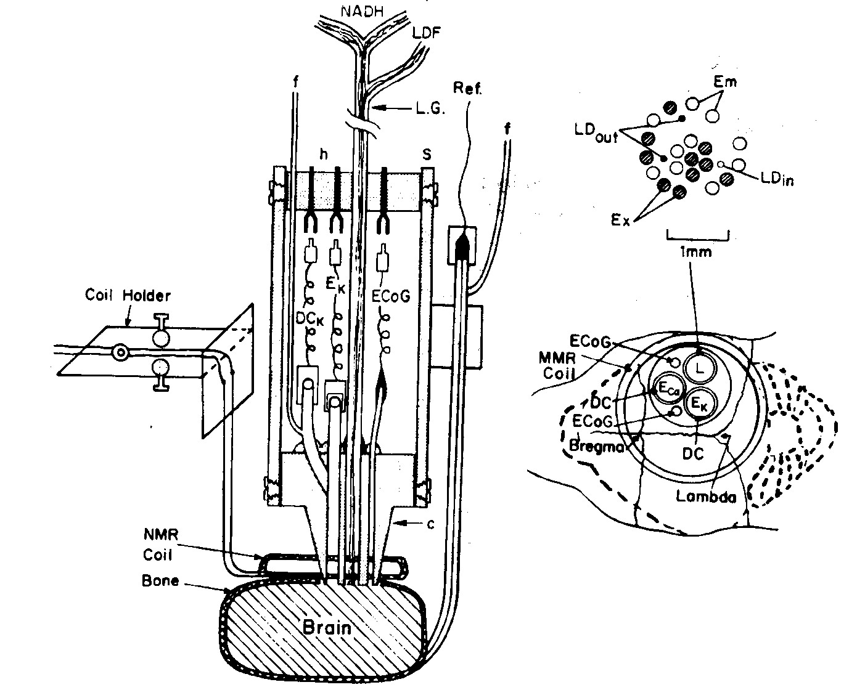
A. Mayevsky, S. Nioka, D. J. Wang and B. Chance, in Oxygen Transport to Tissue XVIII, E. M. Nemoto and J. C. LaManna, Eds., pp. 41-53, Plenum Press, (1997).

Slide 40
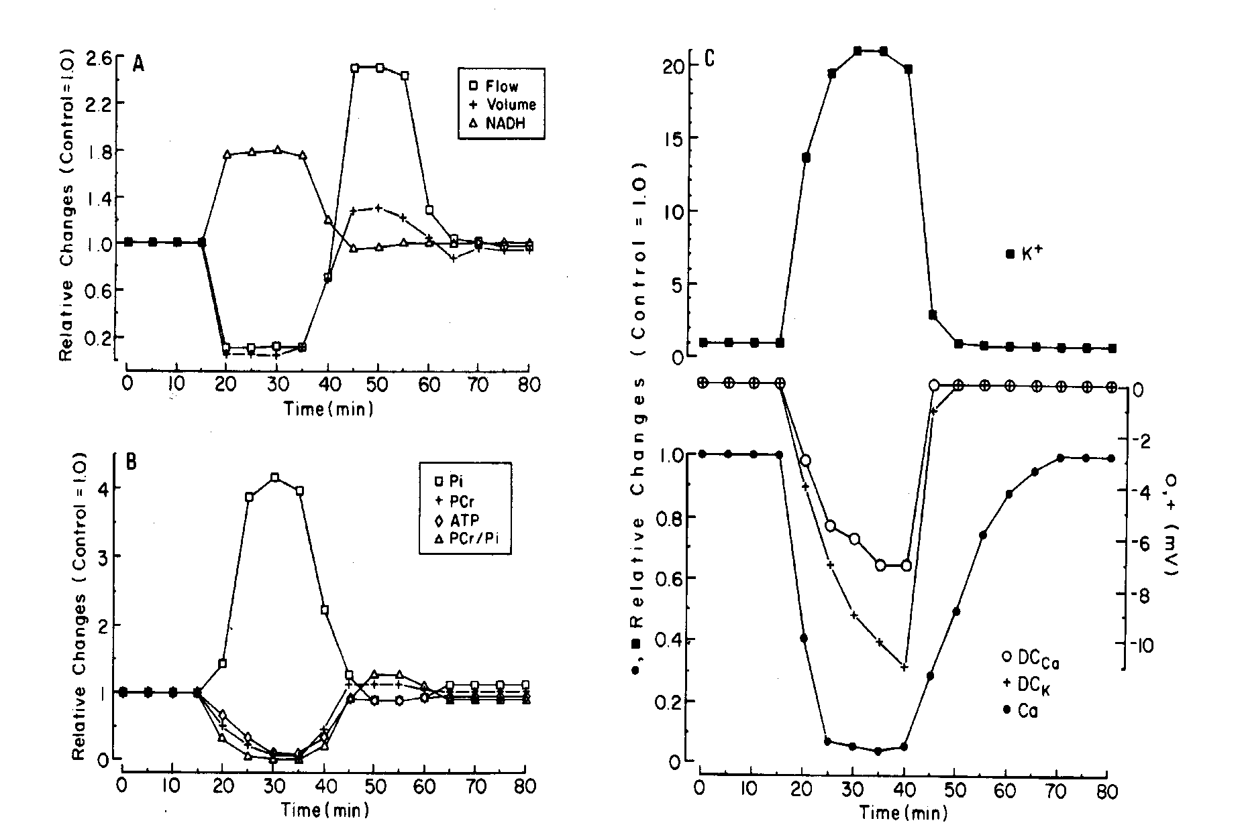
A. Mayevsky, S. Nioka, D. J. Wang and B. Chance, in Oxygen Transport to Tissue XVIII, E. M. Nemoto and J. C. LaManna, Eds., pp. 41-53, Plenum Press, (1997).

Slide 41
A. Mayevsky, E. S. Flamm, W. Pennie and B. Chance, "A fiber optic based multiprobe system for intraoperative monitoring of brain functions," SPIE Proc. 1431, 303-313 (1991)

Slide 42
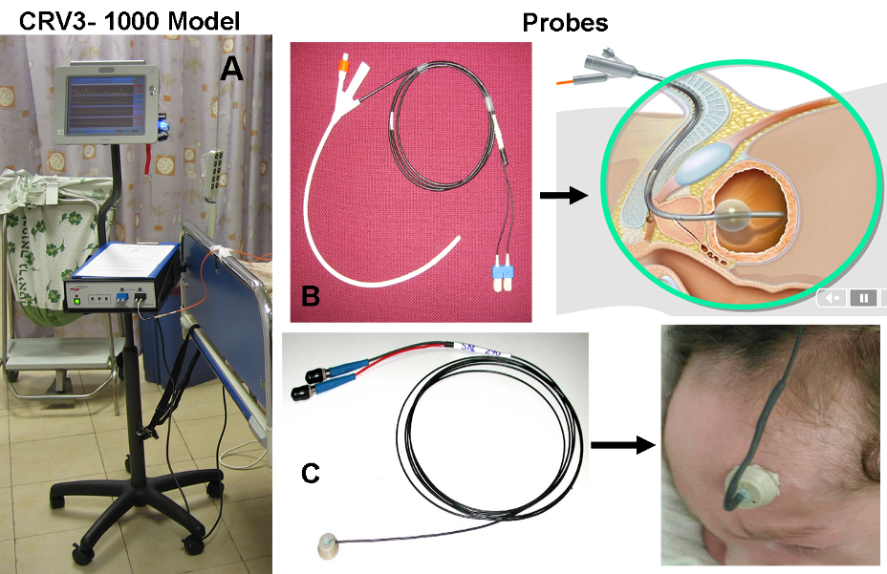
The CritiView Device, Probes and Clinical Applications

Slide 43
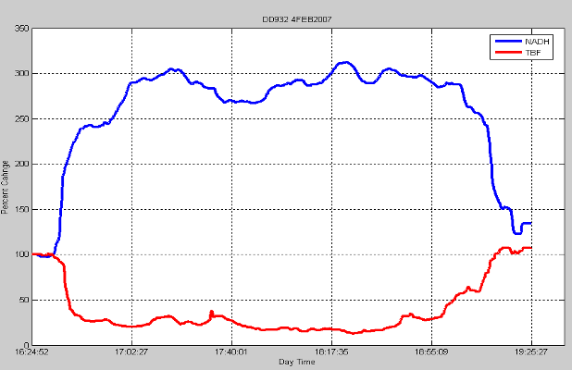
Open Chest Heart Surgery
CABG
38min
Chest open
Pump
on
Pump off
Chest
closure
In this patient the hemodynamic and mitochondrial responses started very early in the operation procedure.

Slide 44
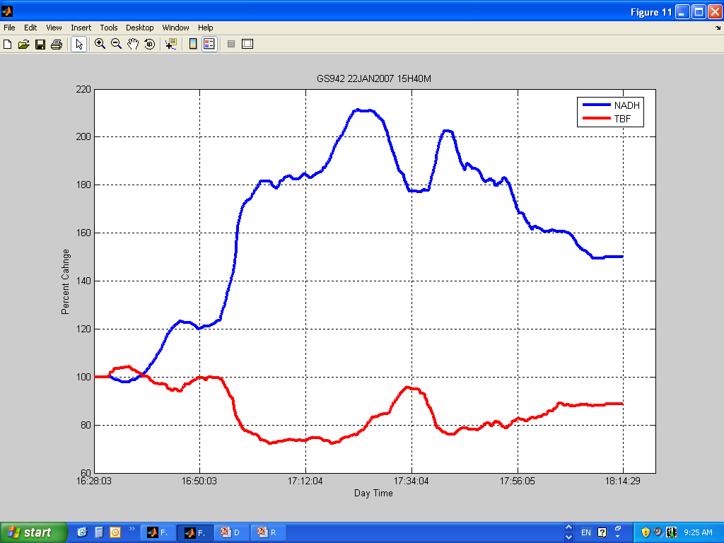
GS942 22 JAN 2007- 15H40M
22min
In this patient clear responses to the procedure were recorded. At 16:49, the pump ON condition led to a large decrease in TBF as well as a large increase in NADH. The signals returned toward the initial values although base line was not reached (monitoring period ends at 18:14)

Slide 45

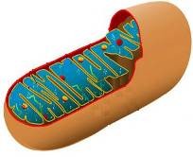
Anoxia
Hypoxia
Hypercapnia
Nimodipine
Ethanol
Anesthetics
Uncoupler
NO
During operation
ICU
CO
Sepsis
Ischemia
Oxygen deficiency
Drugs
Hemorrhage
Clinical
Hyperbaria
HBO
Mannitol
ICP elevation
Retraction
TBI
Brain
Aging
Hypothermia
Activation
Epilepsy
SD
Liver
Ischemia
NE
NADH
Spinal cord
Compression
Ischemia
Small
Intestine
Heart
NE
kidney
Testis
Urethra
Pacing
Hypopnea
Ischemia
Drugs (Ach, NE,
vasoactive)
Animal
Clinical
Pigs
Clinical
N₂
NE
Ischemia
NE
Hypercapnia
Hemorrhage
AAA
ICU
Bypass
Papaverine
Ischemia

Slide 46
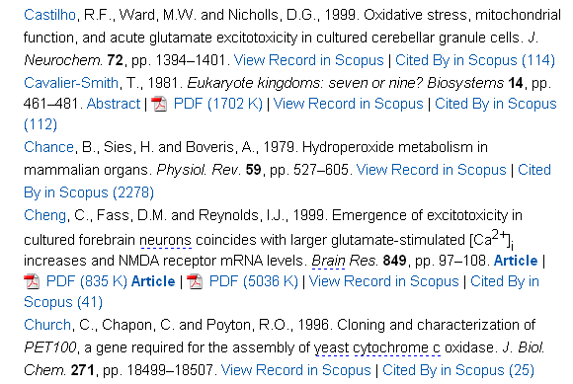
Mitochondrion
Volume 1, Issue 1, June 2001, Pages 3-31
Review article
A century of mitochondrial research: achievements and perspectives
Immo E. Scheffler
Out of 247 References Only one Reference By Chance was cited

Slide 47
Science, 137:499-508, 1962

Slide 48
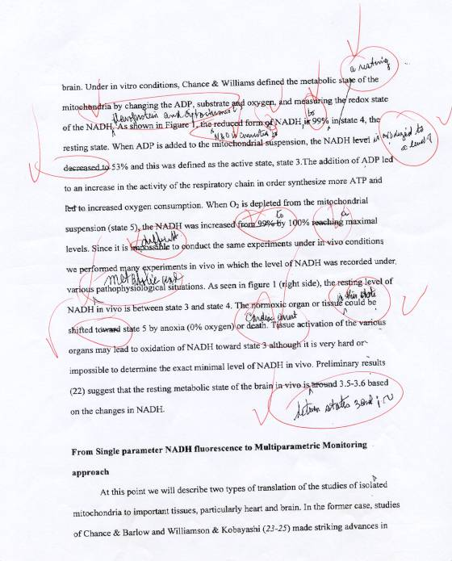

Slide 49
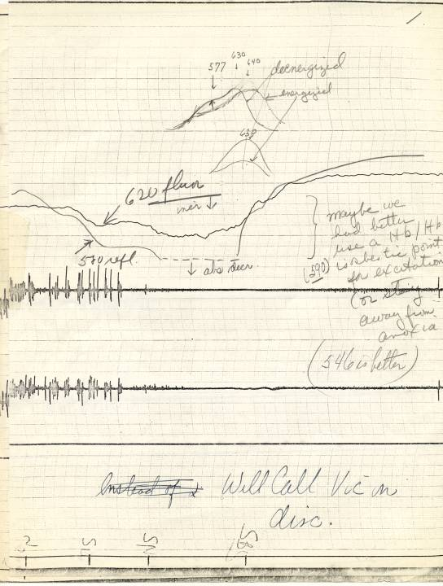

Slide 50
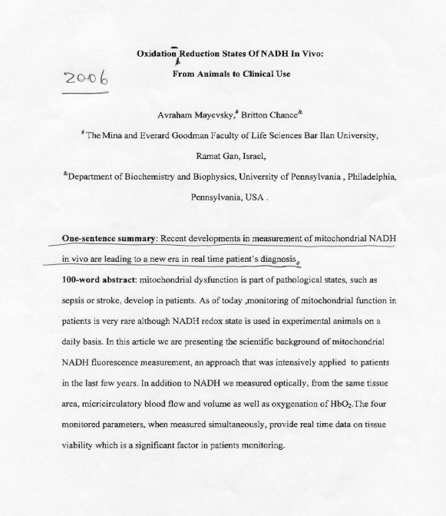

Slide 51
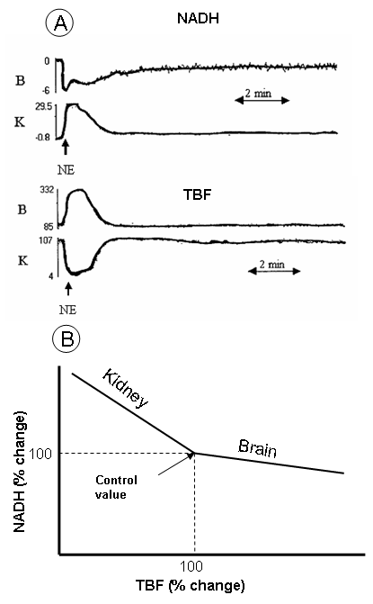
Effects of Adrenaline on various organs
Mayevsky, A. and Chance, B. Mitochondrion 7: 330-339 (2007).

Slide 52
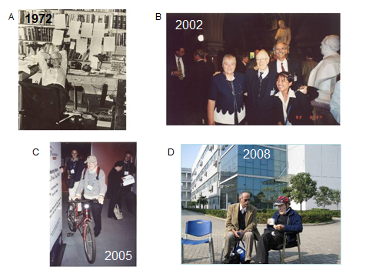
Thank you for the attention

